Slide 1
Game theory
11-10-2022

Slide 2


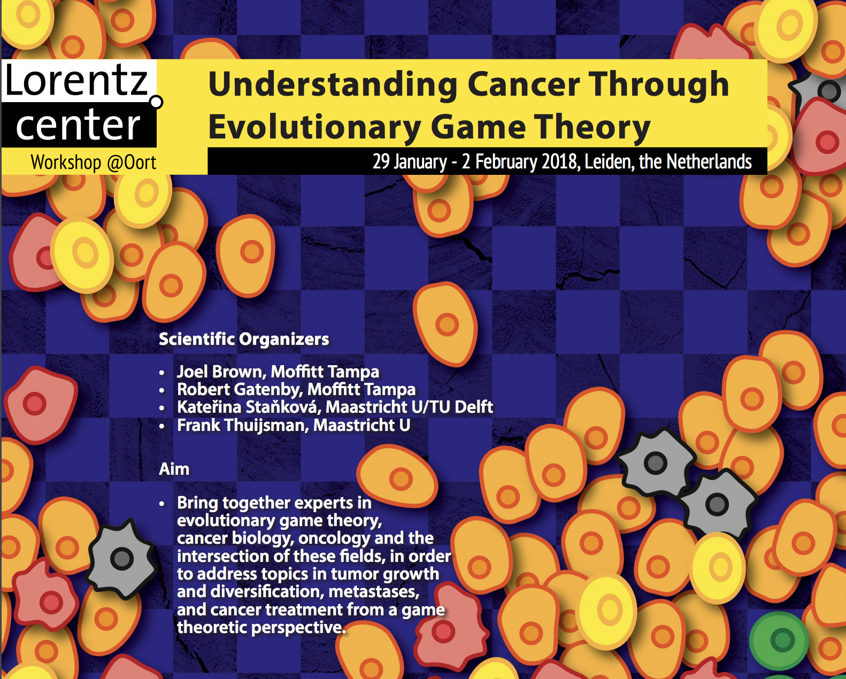
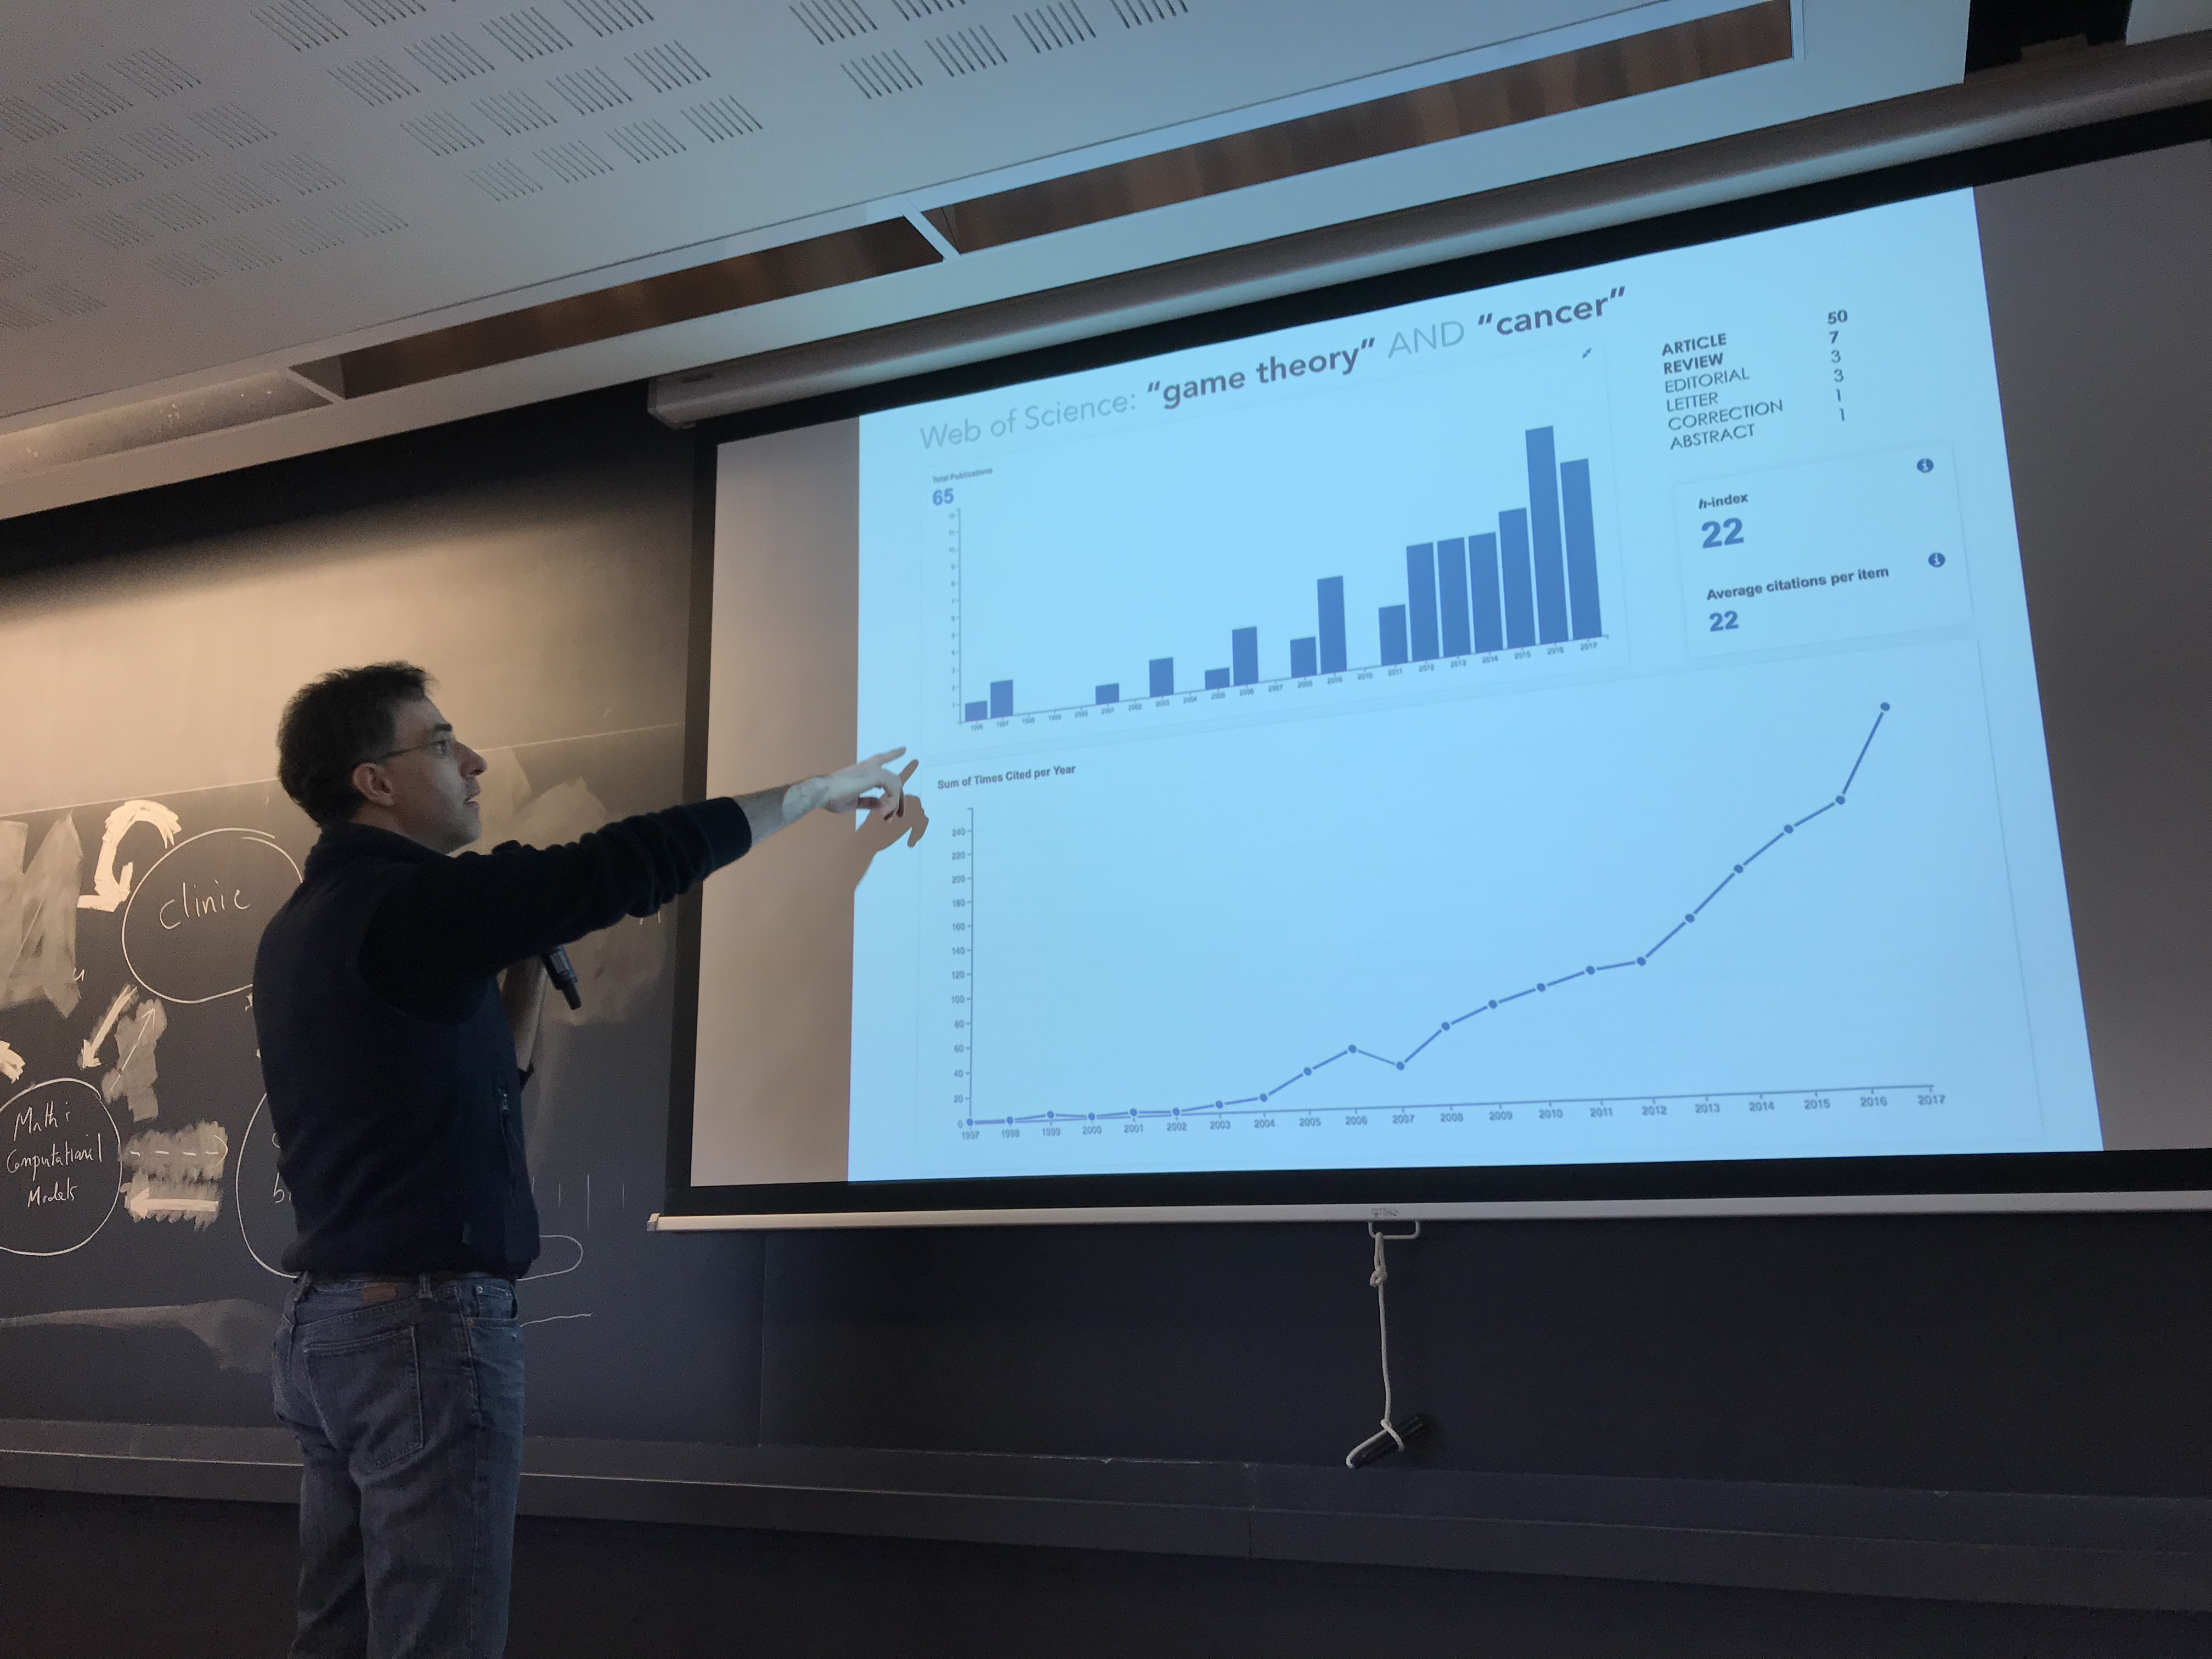
65 papers in about 20 years
A young, emergent field of modeling – but why game theory in cancer?
Leiden, Netherlands
Marco Archetti

Slide 3
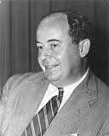
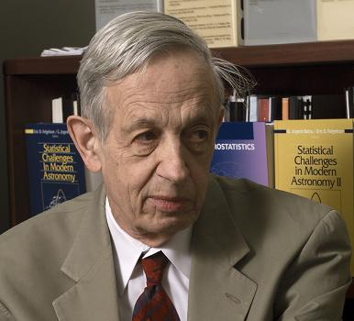
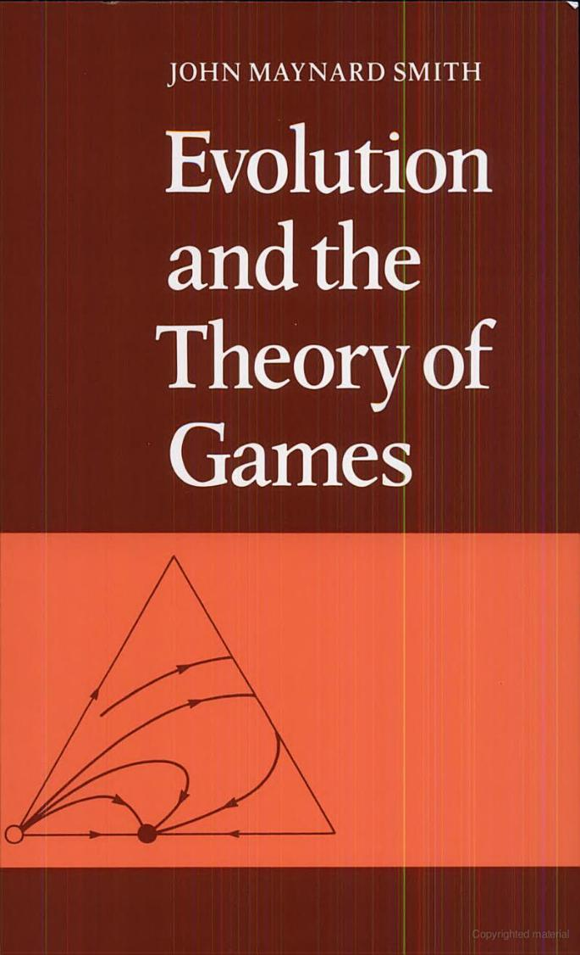
What is… game theory?
Minimax strategies
Nash strategies
Evolutionary
Game Theory
strategic decision making
solving conflicts between rational decision makers
my strategy depends on the strategies of others
Who are the players? What are the strategies?
John von Neumann (1903– 1957)
John Nash (1928 – 2015)
John Maynard Smith (1920 – 2004)
George Price (1922 – 1975)

Slide 4
Consider a “game” determined by the following payoffs:
which strategy would you choose?
 | A | B | C | D
A | 3 | 6 | 5 | 3
B | 5 | 9 | 1 | 2
C | 3 | 11 | 5 | 1
D | 2 | 7 | 6 | 4

Slide 5
A = min-max strategy (minimize the maximum loss scenario)
B = cooperative solution (maximize total payoff)
C = cheaters (take advantage of the cooperators)
D = spiteful (no regrets: Nash equilibrium)
 | A | B | C | D
A | 3 | 6 | 5 | 3
B | 5 | 9 | 1 | 2
C | 3 | 11 | 5 | 1
D | 2 | 7 | 6 | 4

Slide 6
1. Game theory:
Why is it relevant to cancer?
"My real resume is in my cells."
-Jerome from GATTACA-

Slide 7
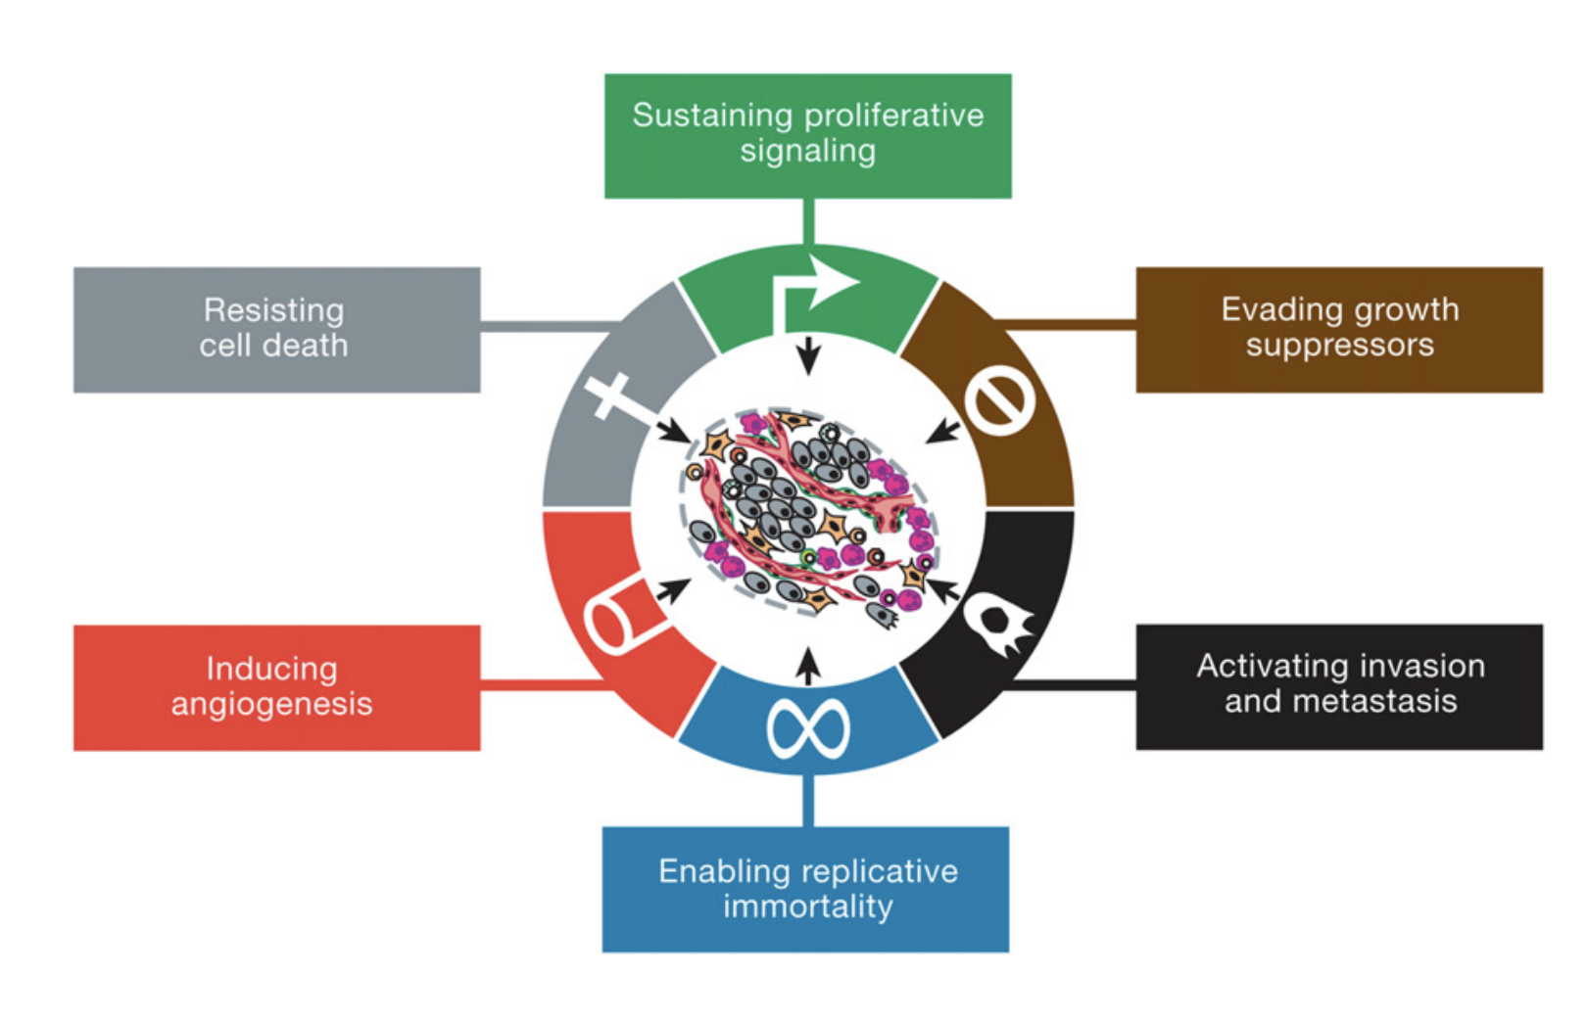
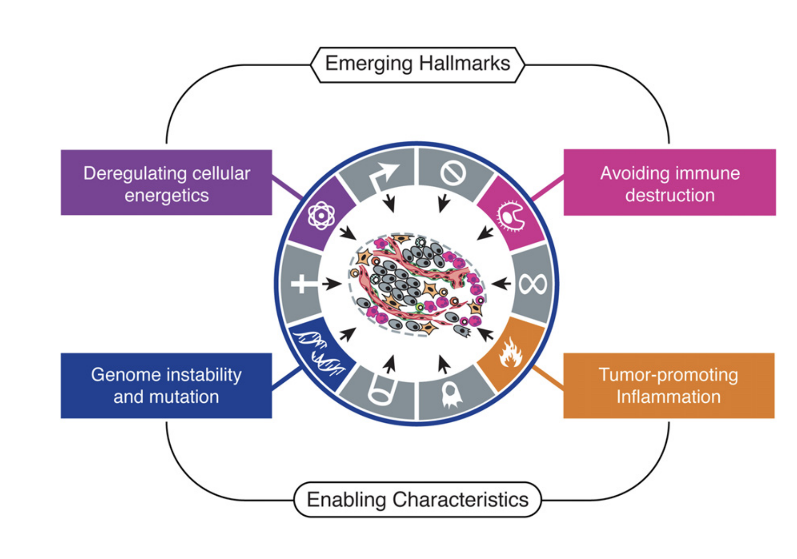
figures from [Hanahan 2011]
What is… cancer?
A disease of the genes?
A disease of unregulated proliferation?
A group of diseases involving abnormal cell growth with the potential to invade or spread?
What are the first principles underlying cancer?
Darwinian dynamics: the ecological dynamics of tumor population sizes and the evolutionary dynamics of heritable phenotypes
Game theory?

Slide 8
The unit of selection: a single cell
Homeostasis
Initiation
Breakout
Somatic mutations
Limited Darwinian evolution
Extensive Darwinian evolution and diversification
Cancer progresses from a disease of the genes
to a disease of natural selection
”Nothing in evolution makes sense except in the light of ecology.”

Slide 9
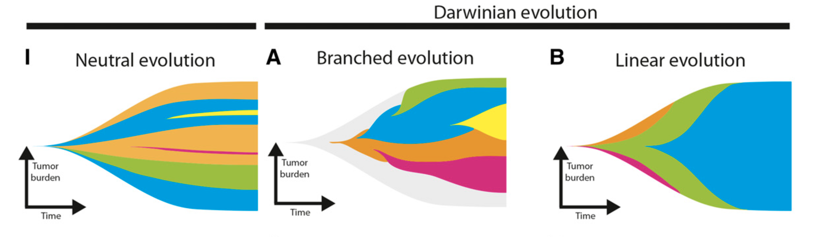
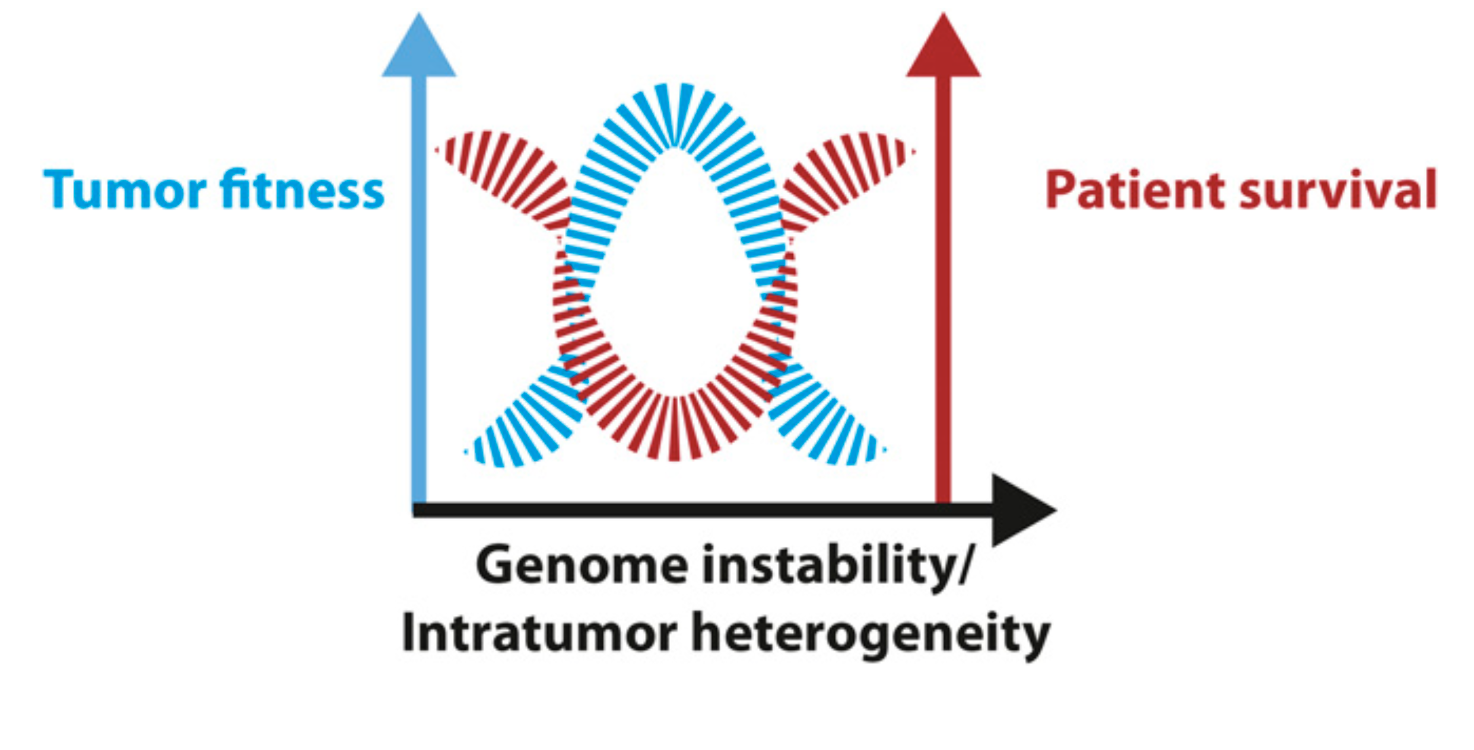
figures from [Venkatesan 2016]
Evo-eco models
Ecology
New clones compete on a fitness landscape dependent on microenvironment and neighbors
Evolution
Genetic changes introduce new clones into the population

Slide 10
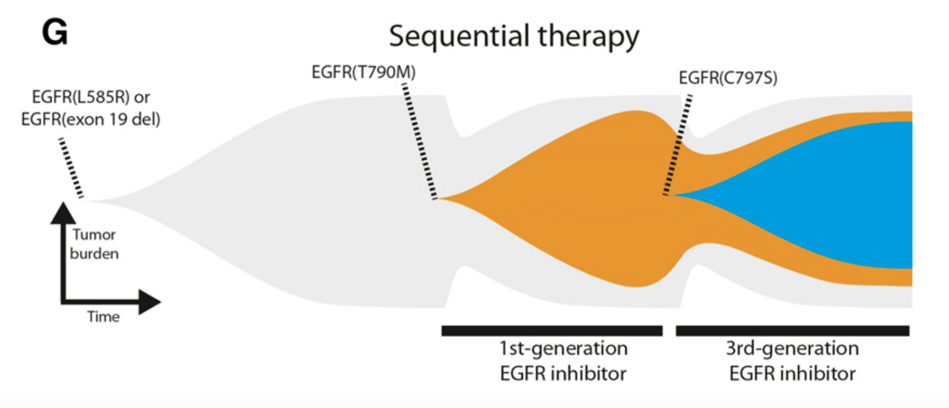
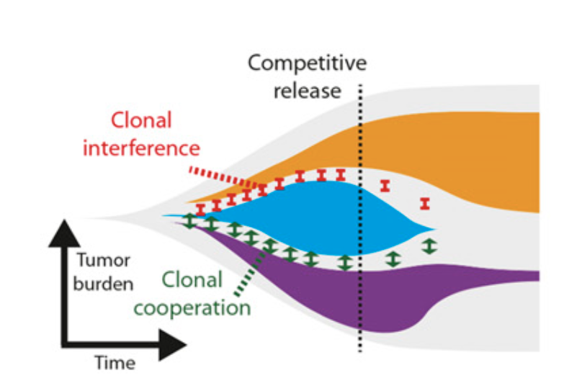
figures from [Venkatesan 2016]
What types of ecological competitive “interactions” are possible in cancer?
Select for resistance
Sequential therapy; repeat until no more drugs
Competitive Release
Absence of sensitive pop. releases resistant pop. from competition

Slide 11
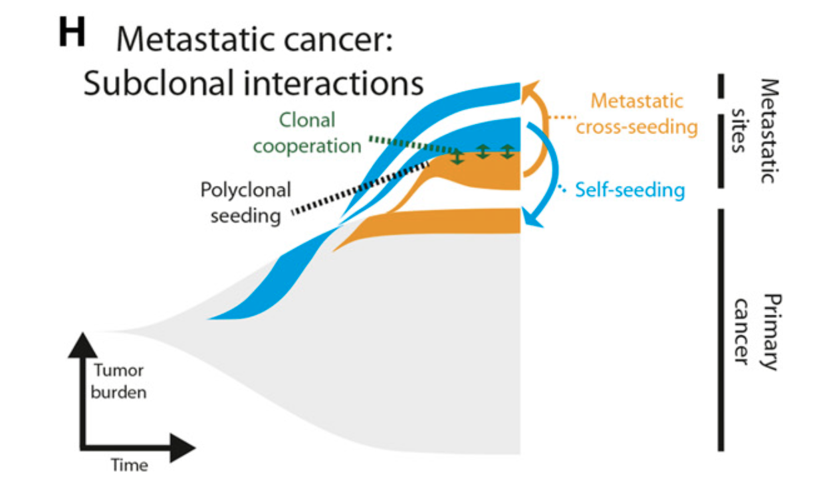
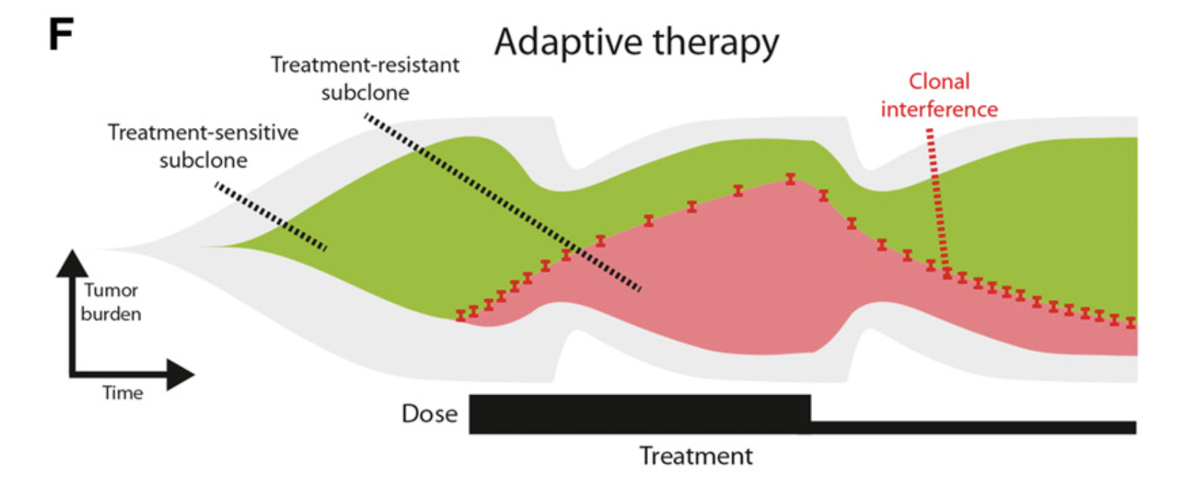
figures from [Venkatesan 2016]
What types of ecological competitive “interactions” are possible in cancer?
Metastasis
Advent of new metastatic sites is a “selection” event
Ecologically-inspired therapy
Taking advantage of clonal interference to design eco-friendly schedules

Slide 12
2. Fitness is relative:
Replicator dynamics
"It's not the notes you play, it's the notes you don't play."
-Mile Davis, on jazz-
"It's not the parameters you use, it's the parameters you don't use."
-Jeffrey West, on modelling-

Slide 13
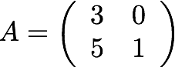
Let’s review important eco-evo concepts:
Natural selection
The “force” of evolution that promotes adaptations
Game theory:
fitness is determined
by payoff matrix
Adaptation
Heritable traits that maximize fitness in a given environment
Prisoner’s Dilemma
Fitness
Per capita growth rate of a clonal population of cells
How do we determine the entries to payoff matrix?

Slide 14
Scripps PS-OC: `Mathematics and Physics of Cancer Metastasis’
Fitness is computed at each cell-cell interaction The Prisoner’s Dilemma
Two players compete against each other for best `payoff’
Each has to decide whether to Cooperate (C) or Defect (D)
What is the best strategy to use to maximize payoff?
Payoff matrix:
If you cooperate, I am better off defecting (5)
If you defect, I am better off defecting (1)
Therefore I should defect no matter what you do!
C
D
Your options
C
BUT: You will analyze the game the same way
and also defect → we each get payoff of 1
Sub-optimal for both players and total (1+1=2)
If we both chose to cooperate, we would each
get a payoff of 3 which is optimal for both and
total (3+3=6)
D
My options
Cancer cells are `defectors’
Healthy cells are `cooperators’

Slide 15
Developing intuition about replicator dynamics Formalizing stability of competing evolutionary strategies
Evolutionarily stable strategies (ESS)
Let E(S,T) represent the payoff for playing strategy S against strategy T:
Two conditions for an ESS:
E(S,S) > E(T,S), or
E(S,S) = E(T,S) and E(S,T) > E(T,T)
Prisoner’s dilemma
Nash equilibrium (invasion)
A strategy which, if adopted by a population in a given environment, cannot be invaded by any alternative strategy that is initially rare
Every ESS corresponds to a Nash equilibrium, but some Nash equilibria are not ESSes.

Slide 16
Developing intuition about replicator dynamics Some canonical two player games
Sample Games
Prisoner’s dilemma Hawk Dove Stag Hunt
In general, games are defined by inequalities

Slide 17
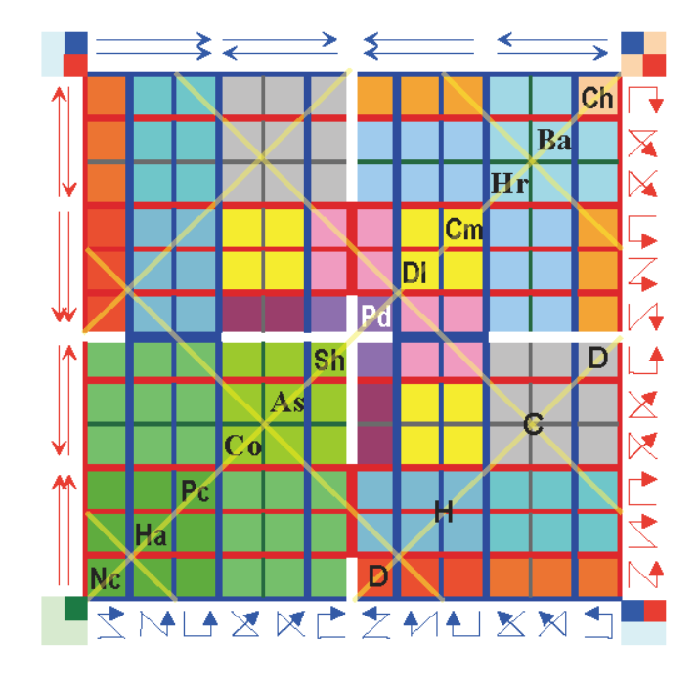
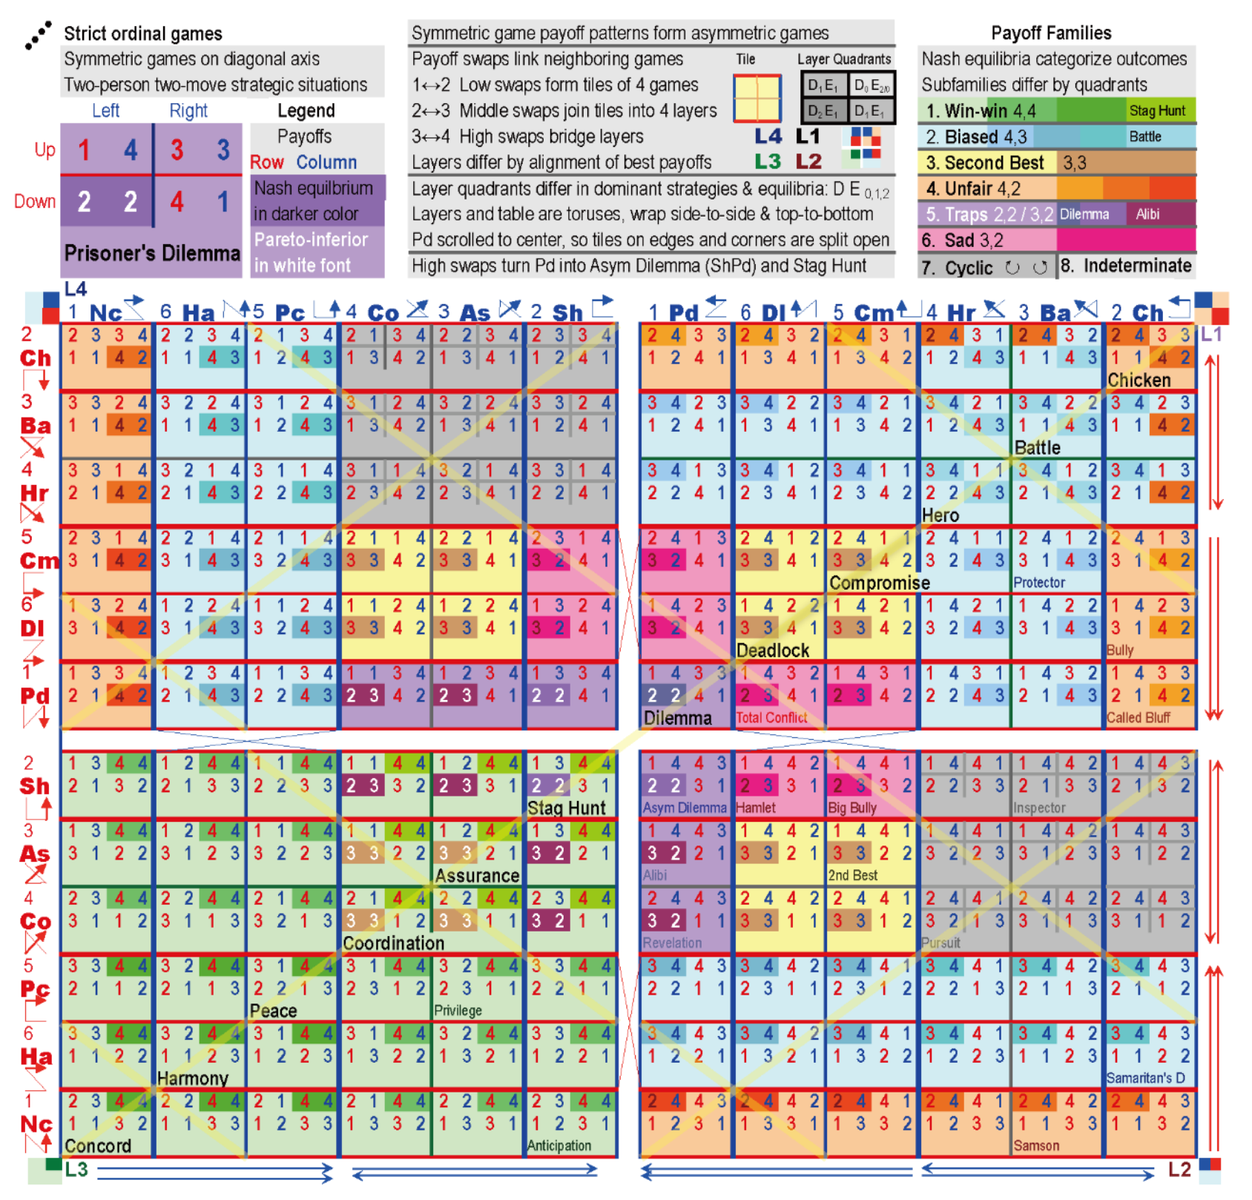
Developing intuition about replicator dynamics A classification of all two player games
If ties are allowed, then there are 726 strategically unique ordinal games
If 4 distinct payoff values (1,2,3,4) only: 144 games

Slide 18
Developing intuition about replicator dynamics Implications of working with frequencies: two player games
Two player game:
Payoff matrix
Calculate the fitness:
All parameters in the model are described by the payoff matrix
Average fitness: weighted average

Slide 19
Developing intuition about replicator dynamics Relative fitness: the payoff matrix is over-parameterized
Two player game:
Payoff matrix
Calculate the fitness:
Plug in:
Only relative fitness matters!
Average fitness: weighted average
Plug in f₁ and f₂

Slide 20
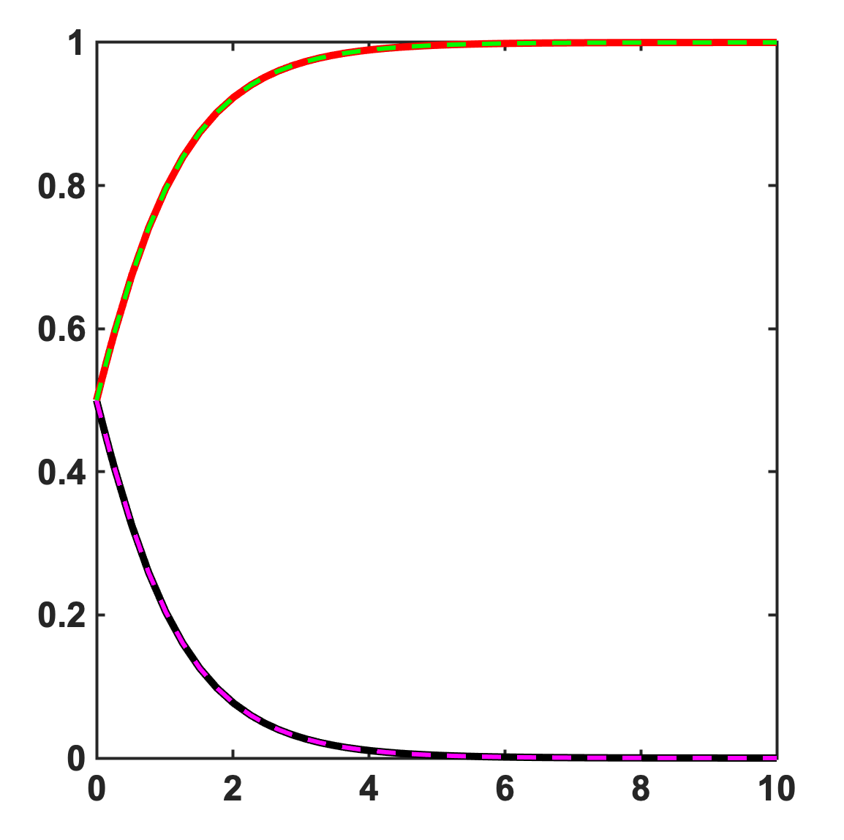
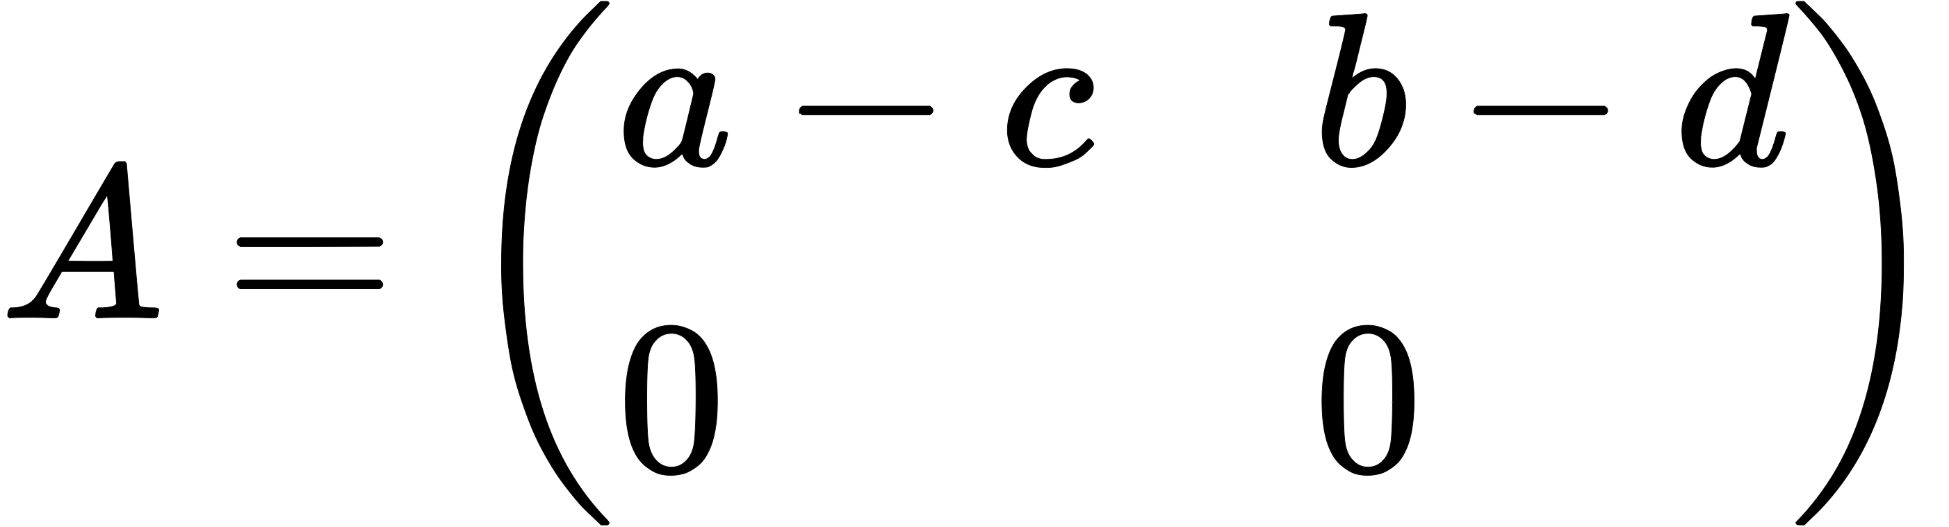
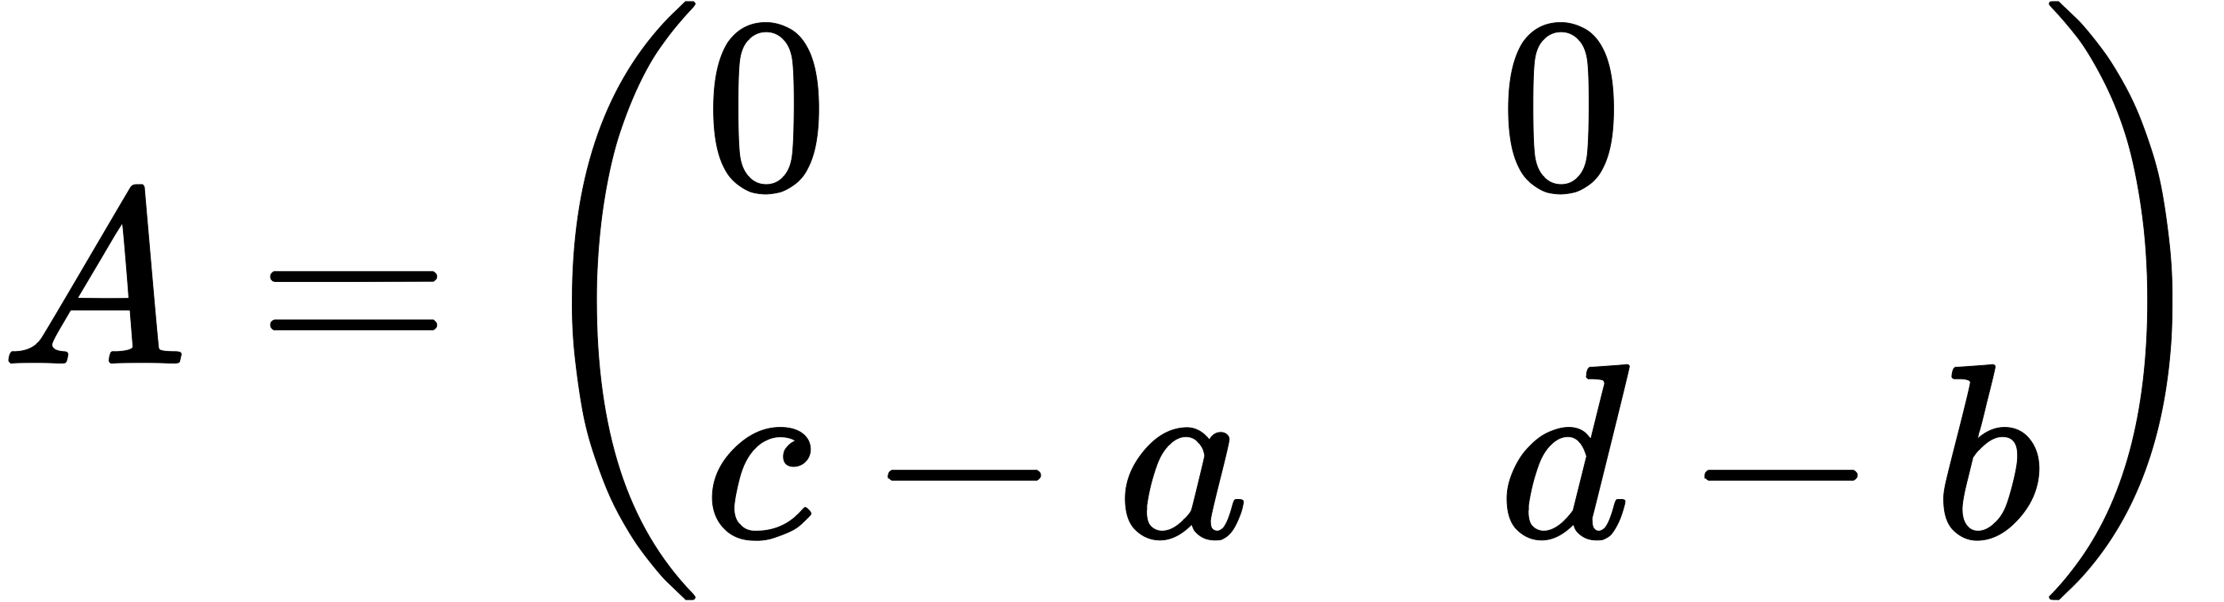
Developing intuition about replicator dynamics Relative fitness: the payoff matrix is over-parameterized
Payoff matrix
x₁, x₂
time

Slide 21
Developing intuition about rep. dyn. All dynamically unique two player games
Frequency dependent selection of Strategy 1 and Strategy 2
2 dominates 1, if a < c and b < d
1
2
Fitness
Fitness
c
c
b
1 dominates 2, if a > c and b > d
Strategy 1 + Strategy 2 = 1
1
2
a
d
a
d
b
1 and 2 coexist if a < c and b > d
0 1
0 1
1
2
x2
x2
100% Strategy 1
100% Strategy 2
100% Strategy 1
100% Strategy 2
1 and 2 are bistable, if a > c and b < d
Fitness
Fitness
1
2
a
a
d
1 and 2 are neutral, if a = c and b = d
b
1
2
c
d
c
b
stable equilibrium
0 1
x2
x2
unstable equilibrium
0 1
100% Strategy 1
100% Strategy 2
100% Strategy 1
100% Strategy 2

Slide 22
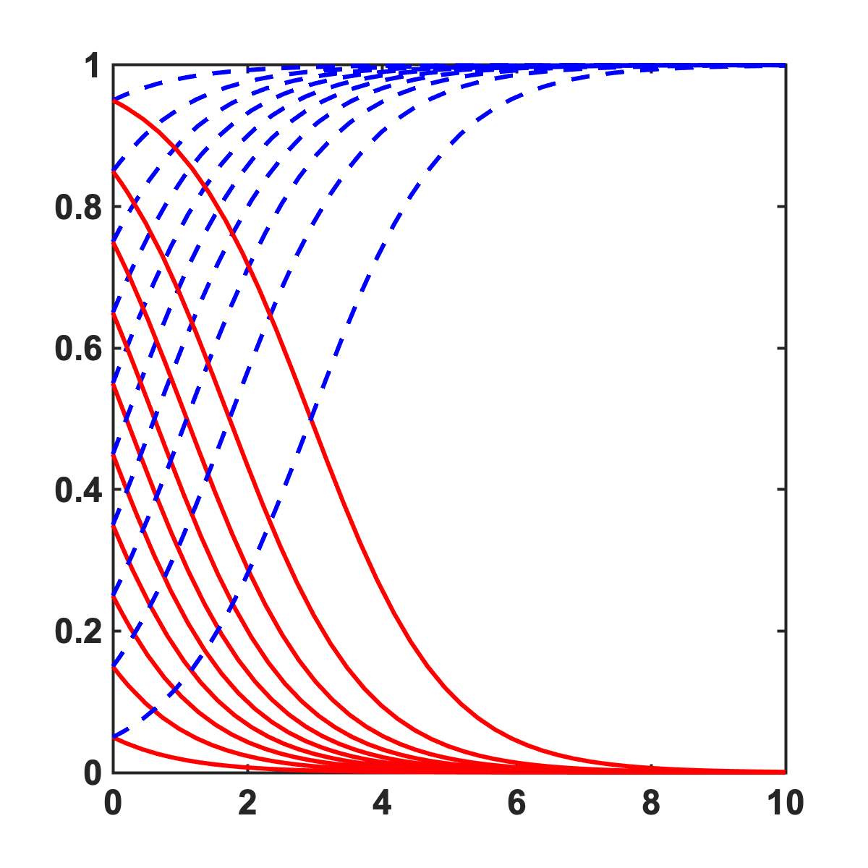
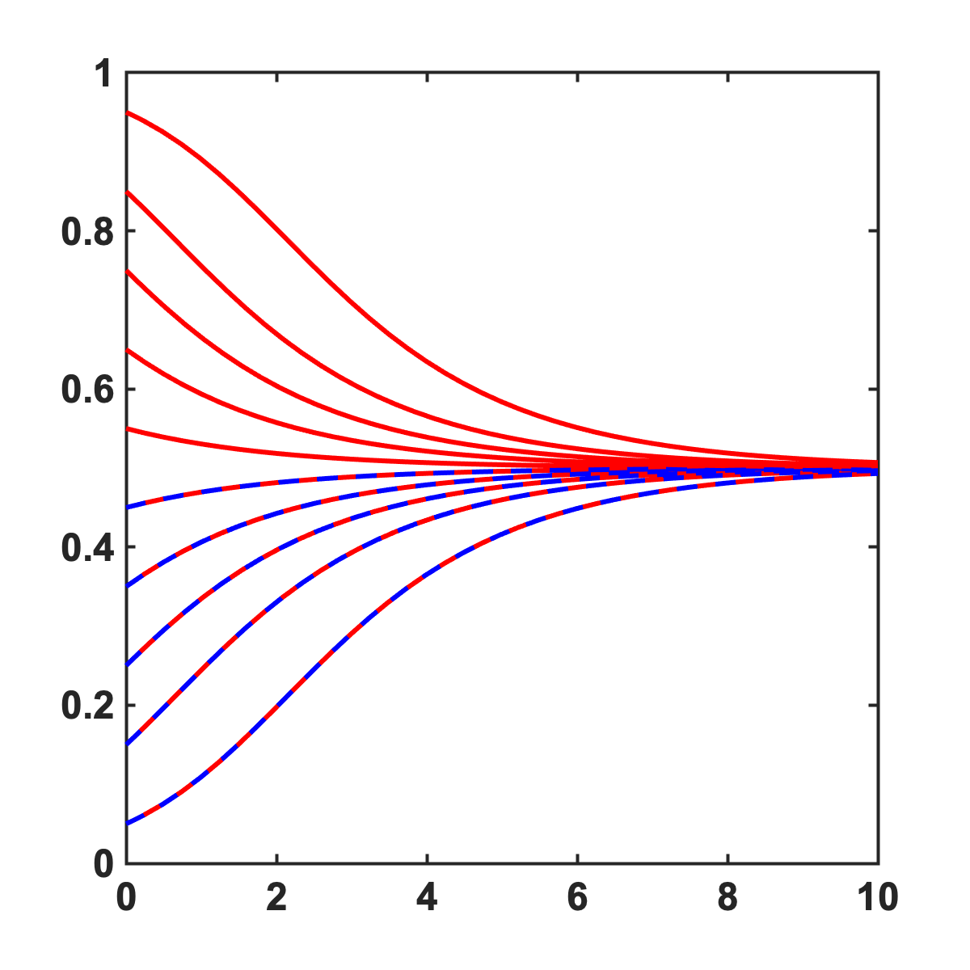
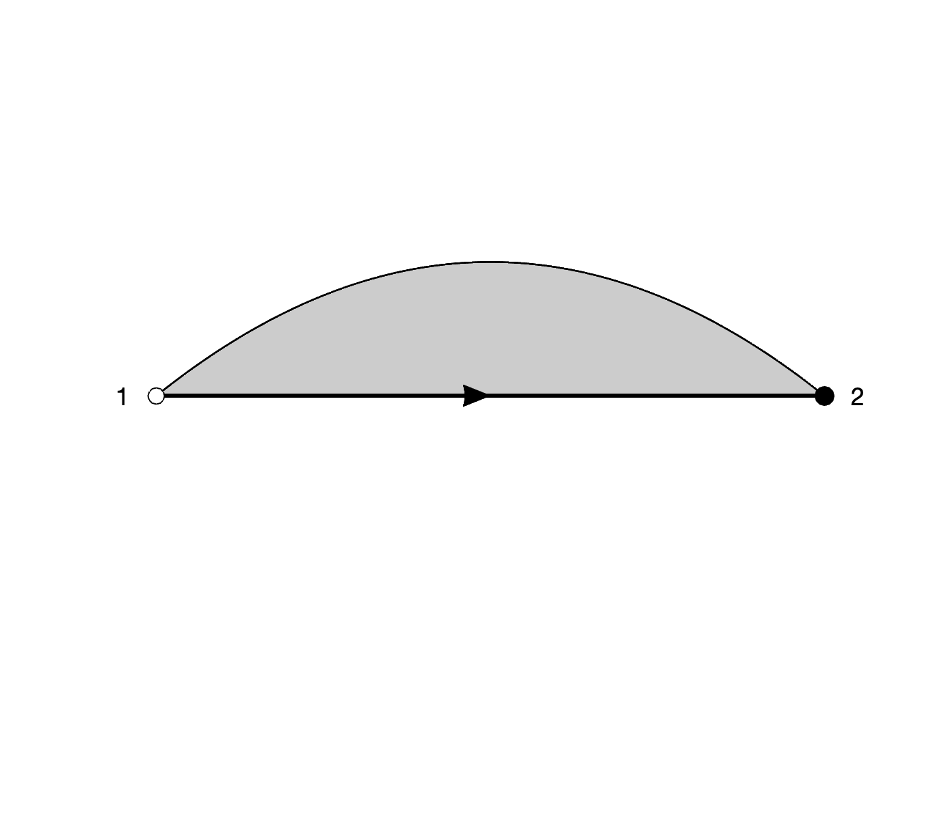
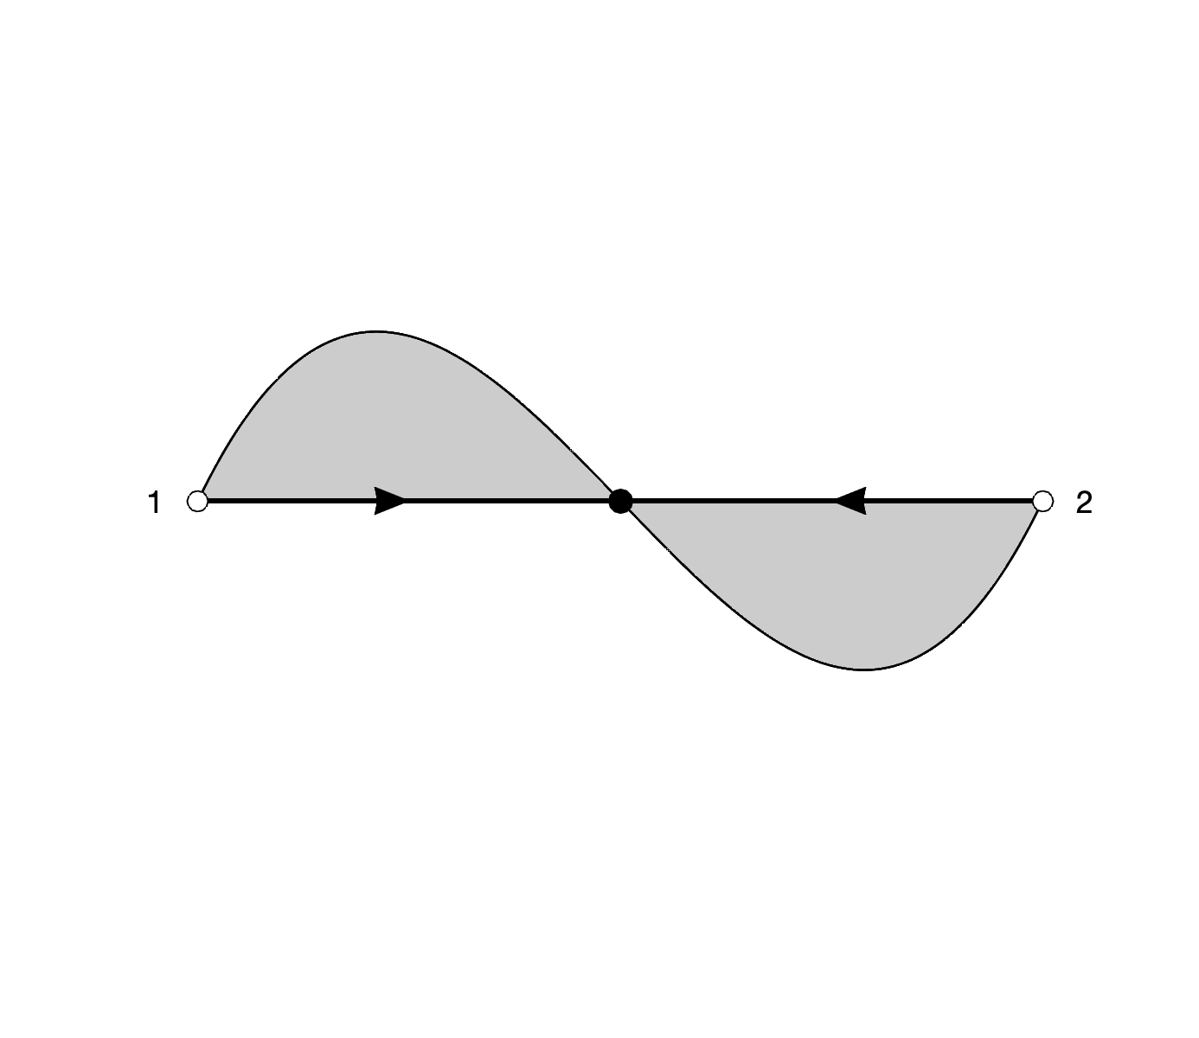
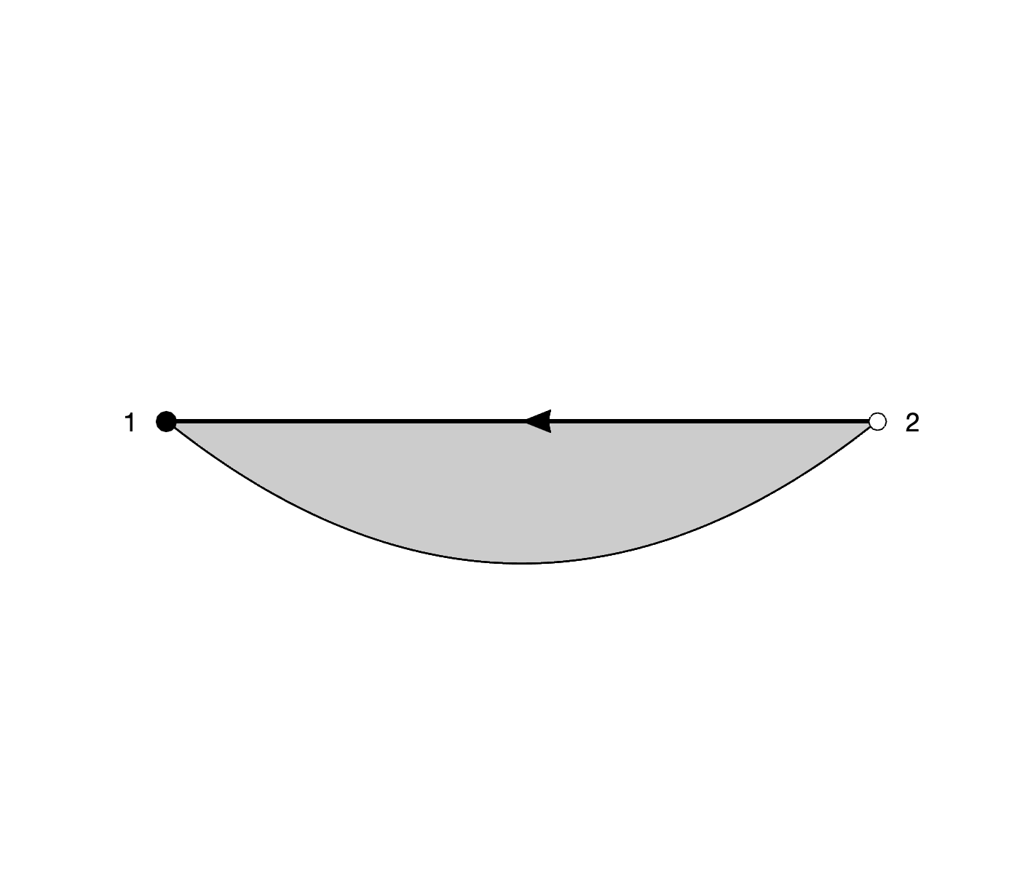
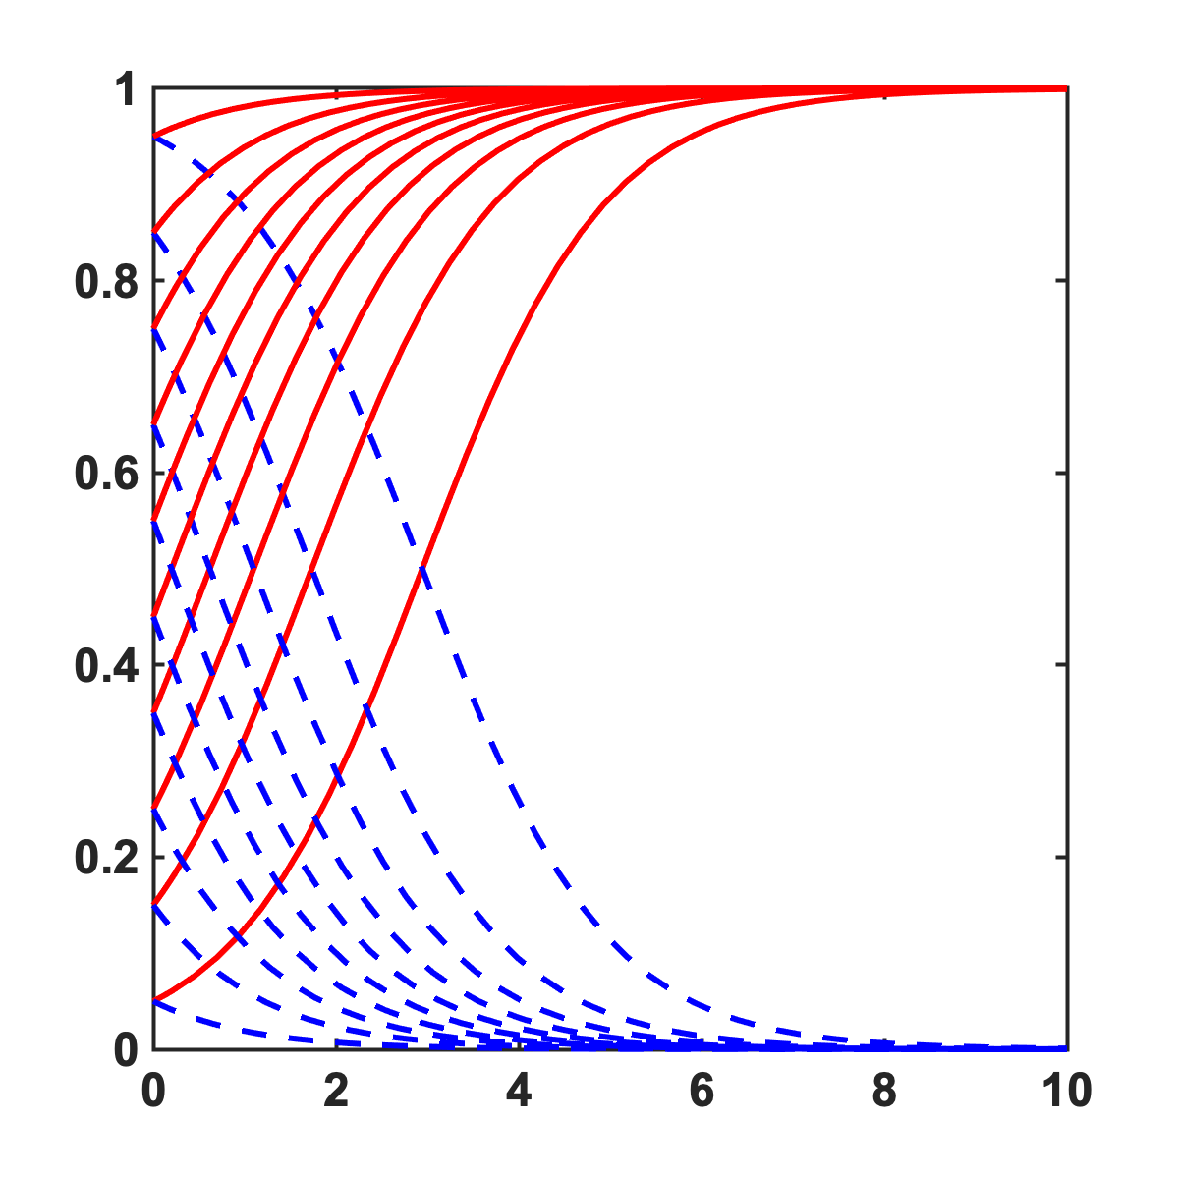
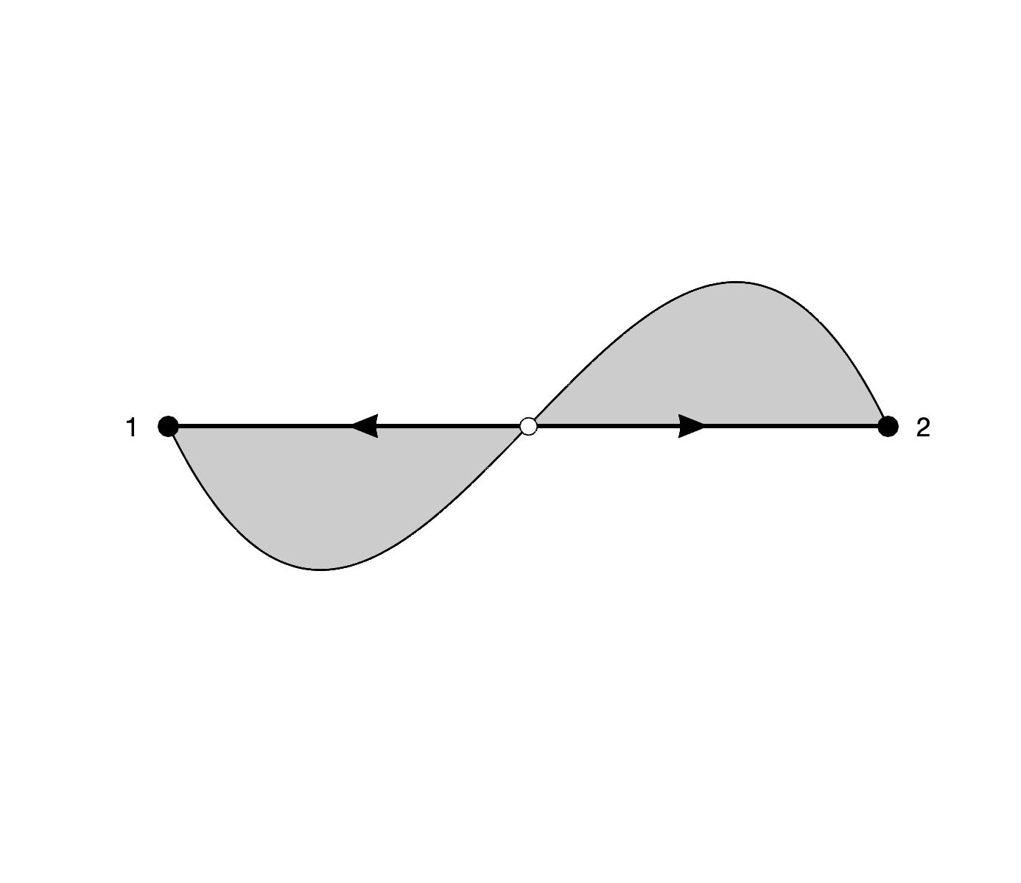
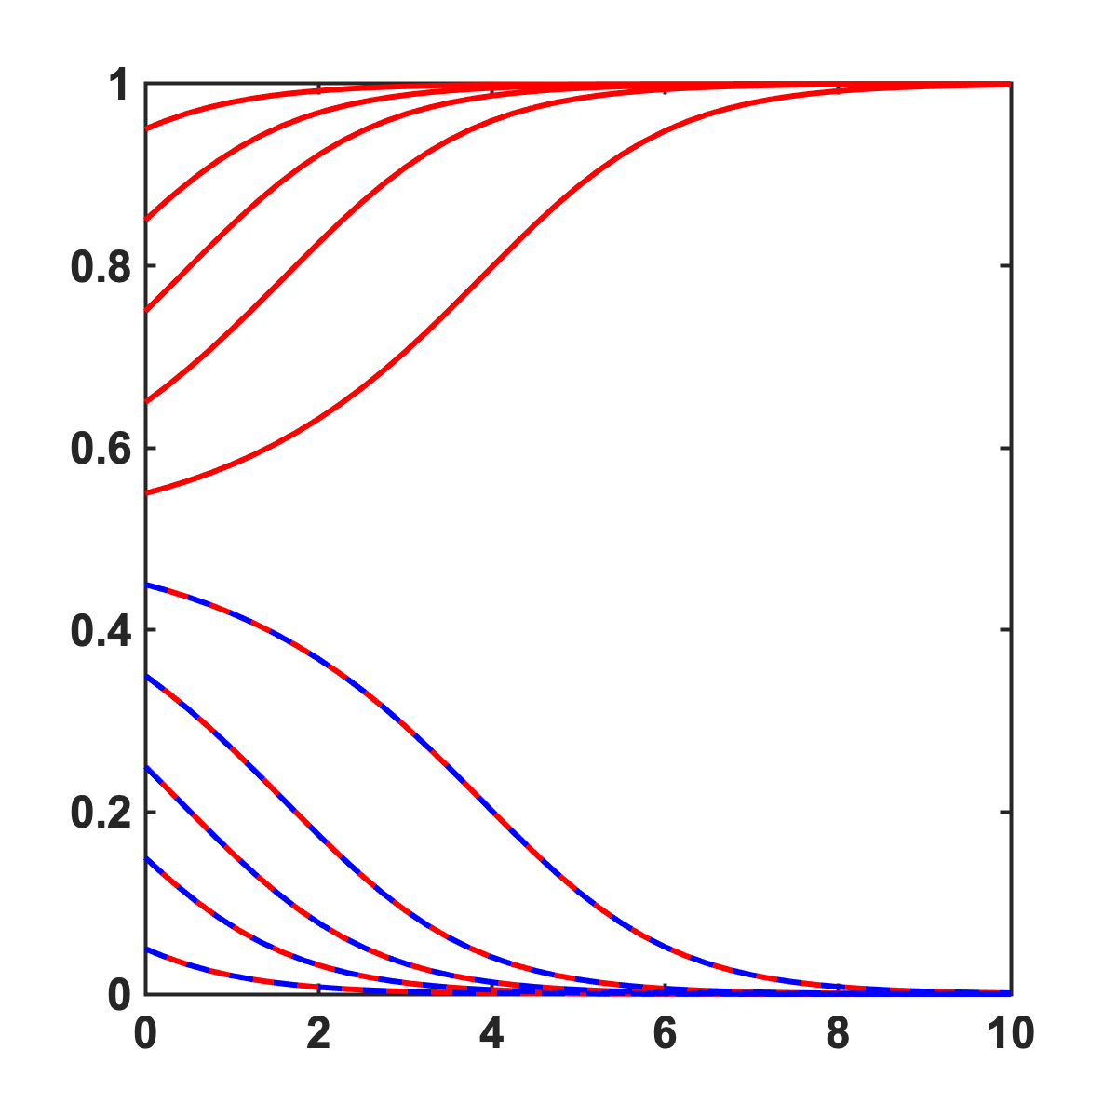
Developing intuition about rep. dyn. Gradient of selection
blue wins
co-existence
x₁, x₂
x₁, x₂
red
blue
red
blue
x₂ (% blue)
x₂ (% blue)
time
time
bi-stability
red wins
x₁, x₂
x₁, x₂
red
blue
red
blue
x₂ (% blue)
x₂ (% blue)
time
time

Slide 23
5. Neoadjuvant trade-offs:
Hormone positive breast cancer
”There are no solutions; there are only trade-offs."
-Thomas Sowell, American economist-

Slide 24
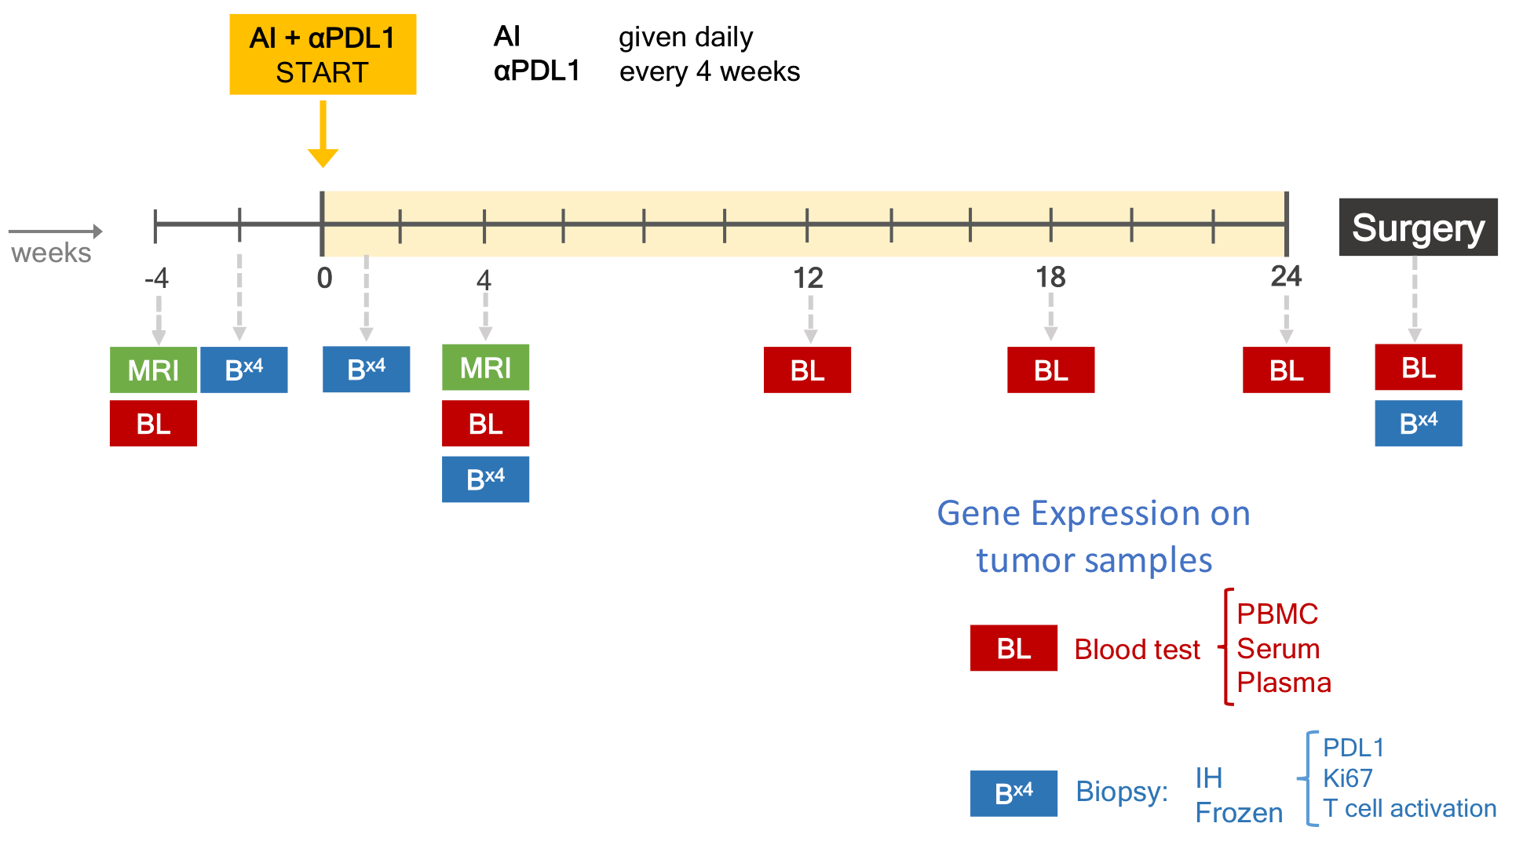
Modeling trade-offs in treatment Endocrine therapy in ER+ breast cancer patients
Clinical trial
Aromatase inhibitors
Anti-PDL1 immunotherapy
Biopsy and blood
baseline
1 month
end of treatment

Slide 25
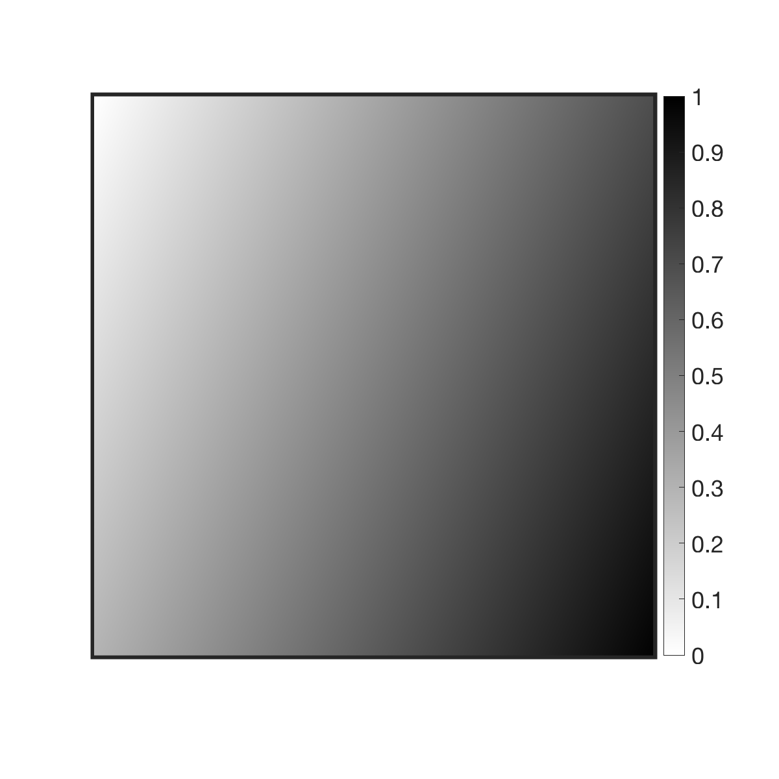
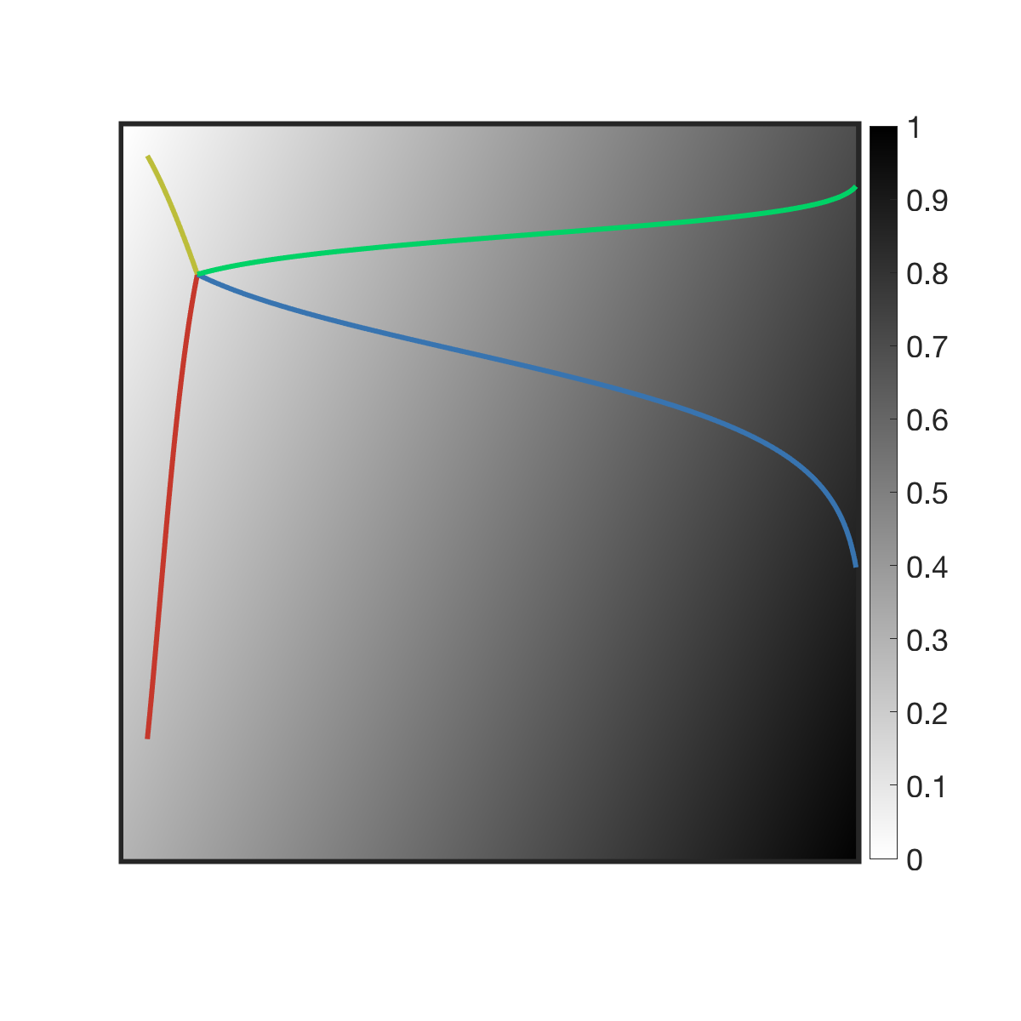
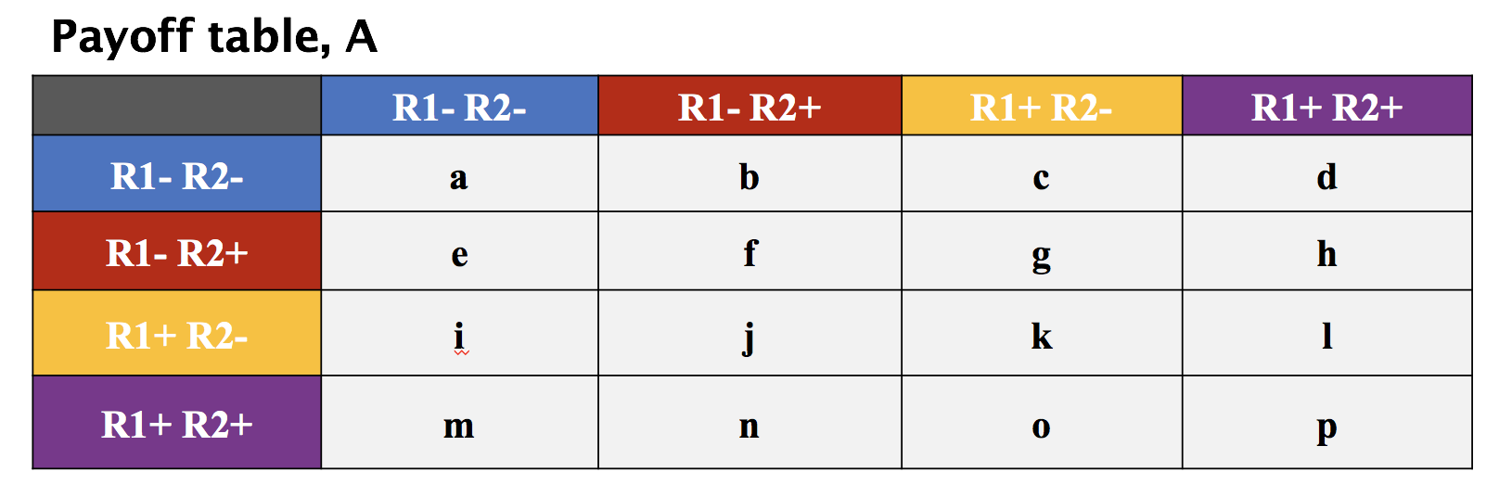
Modeling trade-offs in treatment Endocrine therapy in ER+ breast cancer patients
Two expression axes:
measurable in patients
correlate to poor prognosis
correlate to drug 1, drug 2
total R1 = R1+R2- + R1+R2+
total R2 = R1-R2+ + R1+R2+
Targeted therapy (drug 1)
poor prognosis (metastasis)
R1– R1+
(CCR7 expression)
x₁
x₂
x₃
x₄
R2+ R2- –
Immuno therapy (drug 2)
poor prognosis (metastasis)
x₁ x₂ x₃ x₄
(PDL1 expression)

Slide 26
Modeling trade-offs in treatment Endocrine therapy in ER+ breast cancer patients
Payoff table, A
 | R1- R2- | R1- R2+ | R1+ R2- | R1+ R2+
R1- R2-
R1- R2+
R1+ R2-
R1+ R2+

Slide 27
Modeling trade-offs in treatment Endocrine therapy in ER+ breast cancer patients
Payoff table, A
k_{T} – immune kill
 | R1- R2- | R1- R2+ | R1+ R2- | R1+ R2+
R1- R2- | –k_{T} | – k_{T} | –k_{T} | – k_{T}
R1- R2+
R1+ R2- | –k_{T} | – k_{T} | –k_{T} | – k_{T}
R1+ R2+

Slide 28
Modeling trade-offs in treatment Endocrine therapy in ER+ breast cancer patients
Payoff table, A
k_{T} – immune kill
d₁ – kill rate due to drug 1
 | R1- R2- | R1- R2+ | R1+ R2- | R1+ R2+
R1- R2- | – k_{T} – d₁ | – k_{T} – d₁ | – k_{T} – d₁ | – k_{T} – d₁
R1- R2+ | –d₁ | –d₁ | –d₁ | –d₁
R1+ R2- | –k_{T} | – k_{T} | –k_{T} | – k_{T}
R1+ R2+

Slide 29
Modeling trade-offs in treatment Endocrine therapy in ER+ breast cancer patients
Payoff table, A
k_{T} – immune kill
d₁ – kill rate due to drug 1
d₂ – kill rate due to drug 2
 | R1- R2- | R1- R2+ | R1+ R2- | R1+ R2+
R1- R2- | –k_{T} – d₁ | – k_{T} – d₁ | –k_{T} – d₁ | – k_{T} – d₁
R1- R2+ | –d₁ – d₂k_{T} | –d₁ – d₂k_{T} | –d₁ – d₂k_{T} | –d₁ – d₂k_{T}
R1+ R2- | –k_{T} | – k_{T} | –k_{T} | – k_{T}
R1+ R2+ | –d₂k_{T} | –d₂k_{T} | –d₂k_{T} | –d₂k_{T}

Slide 30
Modeling trade-offs in treatment Endocrine therapy in ER+ breast cancer patients
Payoff table, A
k_{T} – immune kill
d₁ – kill rate due to drug 1
d₂ – kill rate due to drug 2
c₁ – cost to developing drug resistant R1
c₂ – cost to developing immune resistant R2
 | R1- R2- | R1- R2+ | R1+ R2- | R1+ R2+
R1- R2- | –k_{T} – d₁ | – k_{T} – d₁ | –k_{T} – d₁ | – k_{T} – d₁
R1- R2+ | –d₁ – d₂k_{T} – c₂ | –d₁ – d₂k_{T} – c₂ | –d₁ – d₂k_{T} – c₂ | –d₁ – d₂k_{T} – c₂
R1+ R2- | –k_{T} – c₁ | – k_{T} – c₁ | –k_{T} – c₁ | – k_{T} – c₁
R1+ R2+ | –d₂k_{T} – c₁ – c₂ | –d₂k_{T} – c₁ – c₂ | –d₂k_{T} – c₁ – c₂ | –d₂k_{T} – c₁ – c₂

Slide 31
Modeling trade-offs in treatment Endocrine therapy in ER+ breast cancer patients
Payoff table, A
k_{T} – immune kill
d₁ – kill rate due to drug 1
d₂ – kill rate due to drug 2
c₁ – cost to developing drug resistant R1
c₂ – cost to developing immune resistant R2
b₂ – cheater benefit; near a immune resistant cell
 | R1- R2- | R1- R2+ | R1+ R2- | R1+ R2+
R1- R2- | –k_{T} – d₁ | b₂ – k_{T} – d₁ | –k_{T} – d₁ | b₂ – k_{T} – d₁
R1- R2+ | –d₁ – d₂k_{T} – c₂ | –d₁ – d₂k_{T} – c₂ | –d₁ – d₂k_{T} – c₂ | –d₁ – d₂k_{T} – c₂
R1+ R2- | –k_{T} – c₁ | b₂ – k_{T} – c₁ | –k_{T} – c₁ | b₂ – k_{T} – c₁
R1+ R2+ | –d₂k_{T} – c₁ – c₂ | –d₂k_{T} – c₁ – c₂ | –d₂k_{T} – c₁ – c₂ | –d₂k_{T} – c₁ – c₂

Slide 32
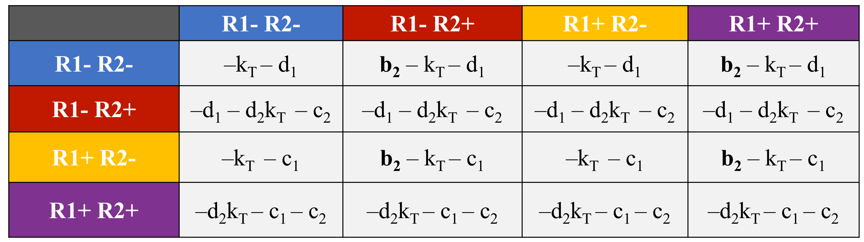
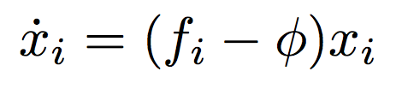
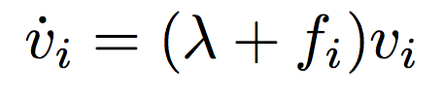
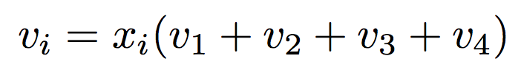
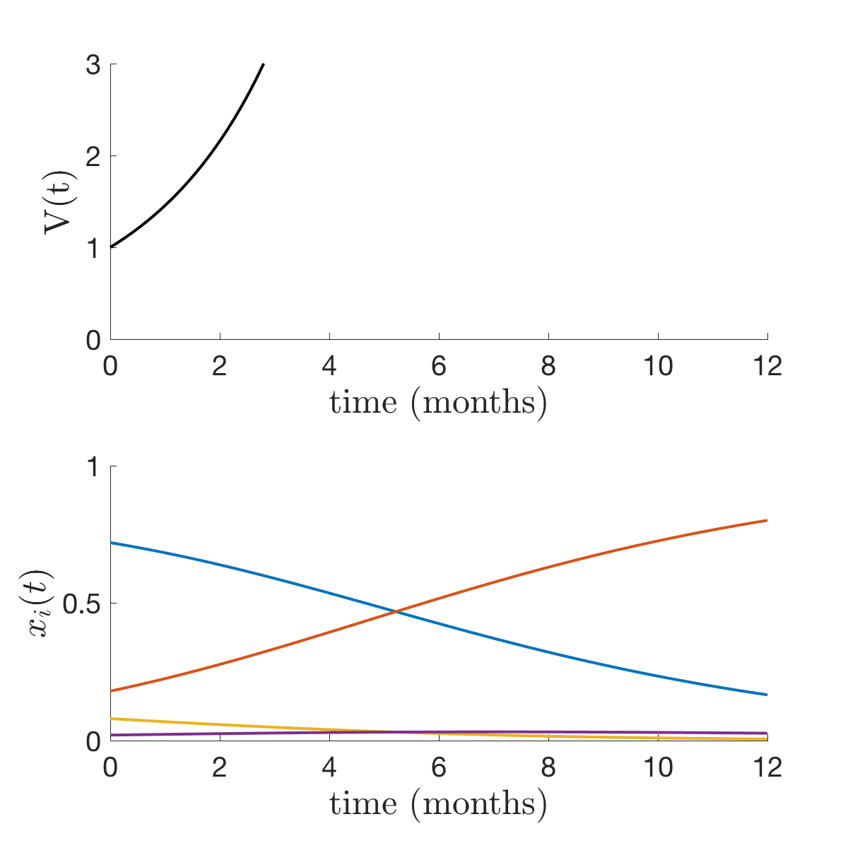
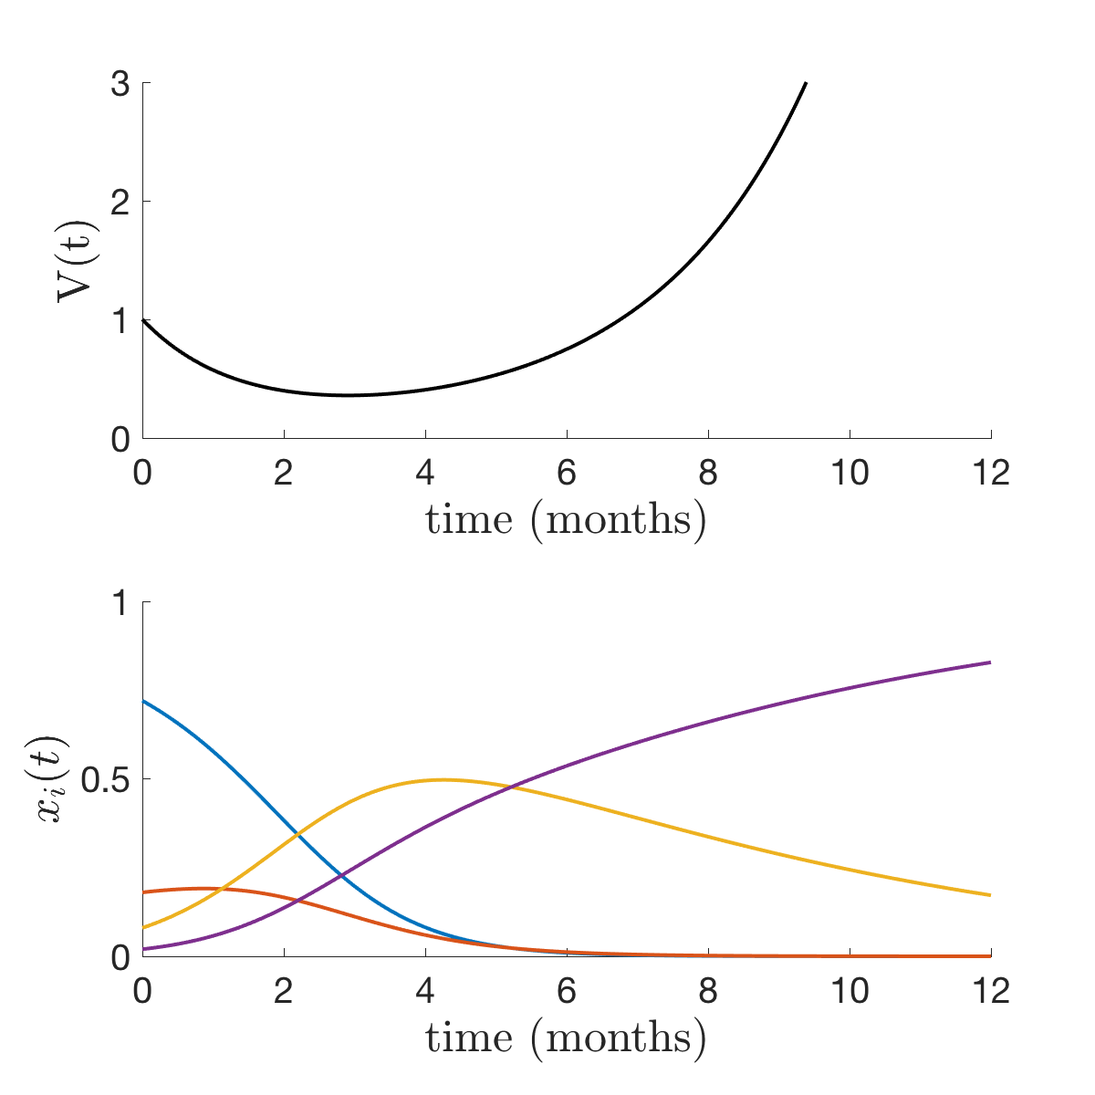
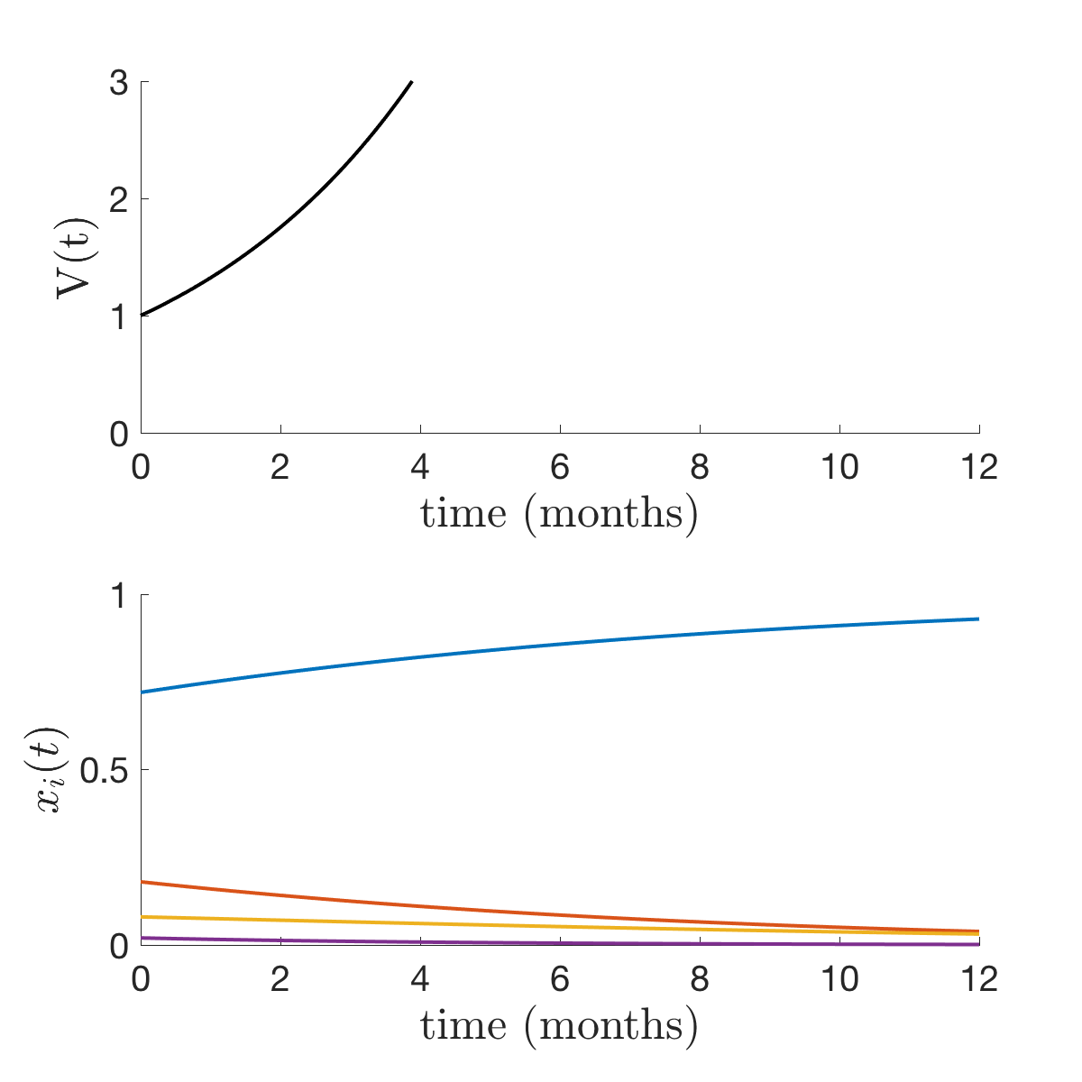
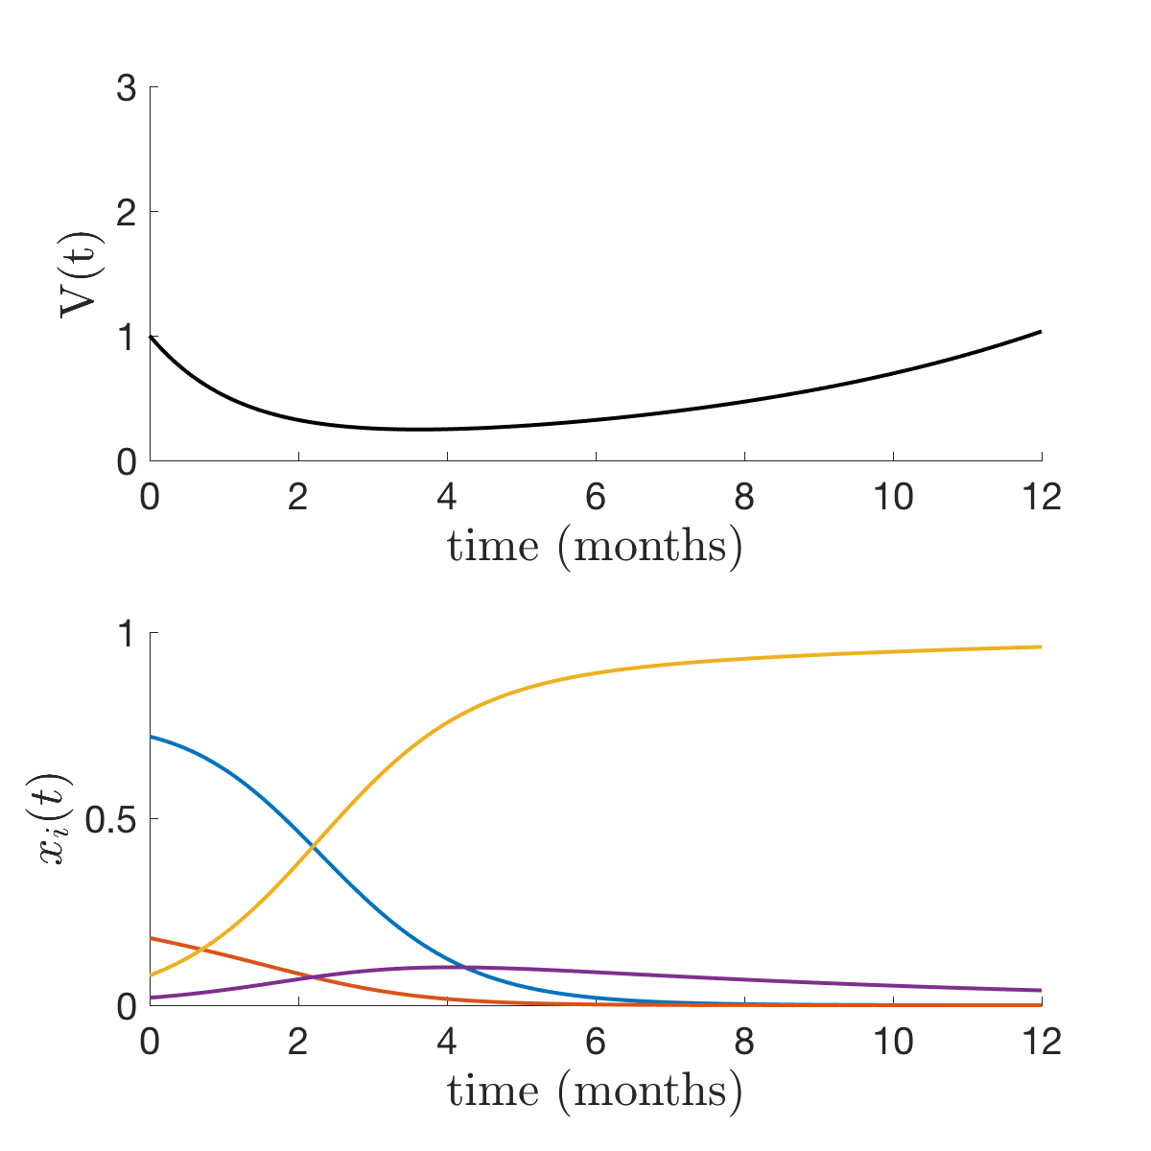
Finding evolutionarily stable states
Replicator dynamics Competing phenotypes
Population dynamics Fitness as per capita growth rate
No treatment d₁=d₂=0
Aromatase inhibitor d₂=0
anti-PDL1 d₁=0
Both therapies
CCR7- PDL1+ wins! if k_{T} > c₂
CCR7+ PDL1+ wins! if d₁ > c₁
CCR7- PDL1- wins! if k_{T} – d₂ k_{T} < c₂
CCR7+ PDL1- wins! if k_{T} – d₂ k_{T} < c₂

Slide 33
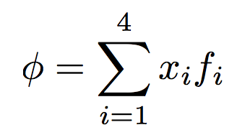
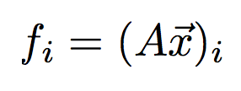
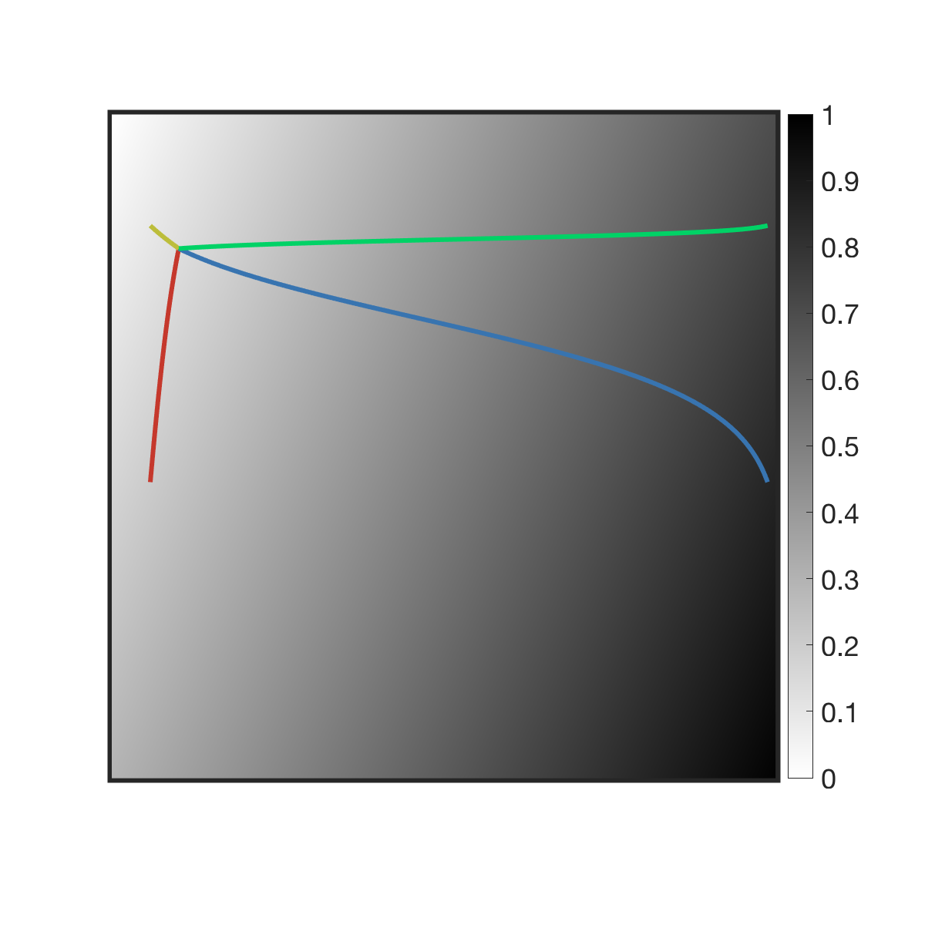
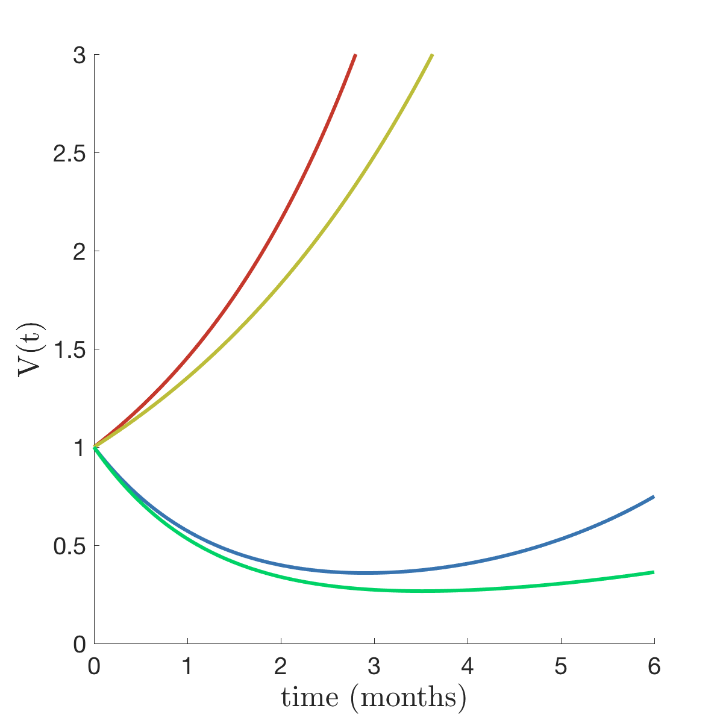
Modeling the trade off between population dynamics and evolutionary dynamics
Replicator dynamics Competing phenotypes
Population dynamics Fitness as per capita growth rate
R1 – R1+
Legend
No Treatment
AI treatment only
AI with PD-L1
anti-PD-L1 treatment only
R2+ R2 –

Slide 34
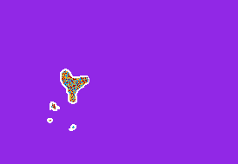
Game theory modelling in cancer:
Pick a game (Prisoner’s dilemma)
Extend previous math models to an evolutionary framework
Intuitive fitness landscape ordering of clones
Normal, sensitive, resistant clones
Changes with/without therapy
Parameters inside payoff matrix
Calculate the emergent evolutionary stable state criteria
Useful hypothesis testing
Spatial games
Local interactions

Slide 35
3. Stochastic models
Moran process

Slide 36
Replicator Equation
Moran Process
deterministic
continuum limit of
stochastic
Notes:
c = [0.5, 0.6, 0.7]
p1 = 0.2
p2 = 0.18
p3 = 0.7
w = 0.1
scale = 25
f = 1e-3

Slide 37
Fitness landscape Selection via Prisoner’s dilemma
Healthy Cells
N - i
i
Cancer Cells
Selection Pressure
Parameter: w
Prisoner’s Dilemma
Payoff Matrix
C
D
Players (i.e. cells) cannot change strategies
The strategies do not evolve, it is the prevalence of each cell type in the population that is evolving
(Random drift,
no selection)
(Selection has full effect,
prisoner’s dilemma)
C
D
w = 0
w = 1
Cooperators: Healthy
Defectors: Cancer
w
Healthy Cells
probability of cancer cell birth
Cancer Cells
probability of healthy cell death

Slide 38
Fitness landscape Selection via Prisoner’s dilemma
Example Simulation
Prisoner’s Dilemma
Payoff Matrix
C
D
Players (i.e. cells) cannot change strategies
The strategies do not evolve, it is the prevalence of each cell type in the population that is evolving
C
tumor growth
D
Cooperators: Healthy
Defectors: Cancer
Healthy Cells
decrease of organism fitness
Cancer Cells
Cancer cells and Healthy cells try to maximize their payoff
But the overall fitness of the organism declines

Slide 39
4. IsoMaTrix
A tool for visualizing matrix games
”The best investment is in the tools of own’s own trade.”
- Benjamin Franklin -
https://github.com/mathonco/isomatrix

Slide 40

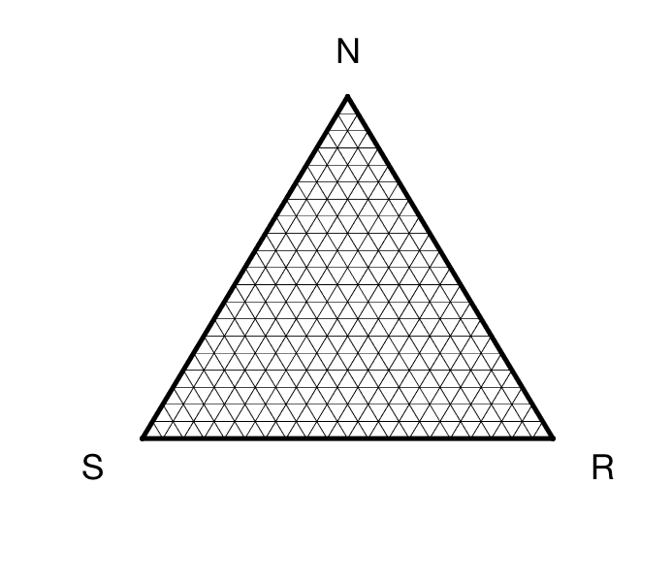
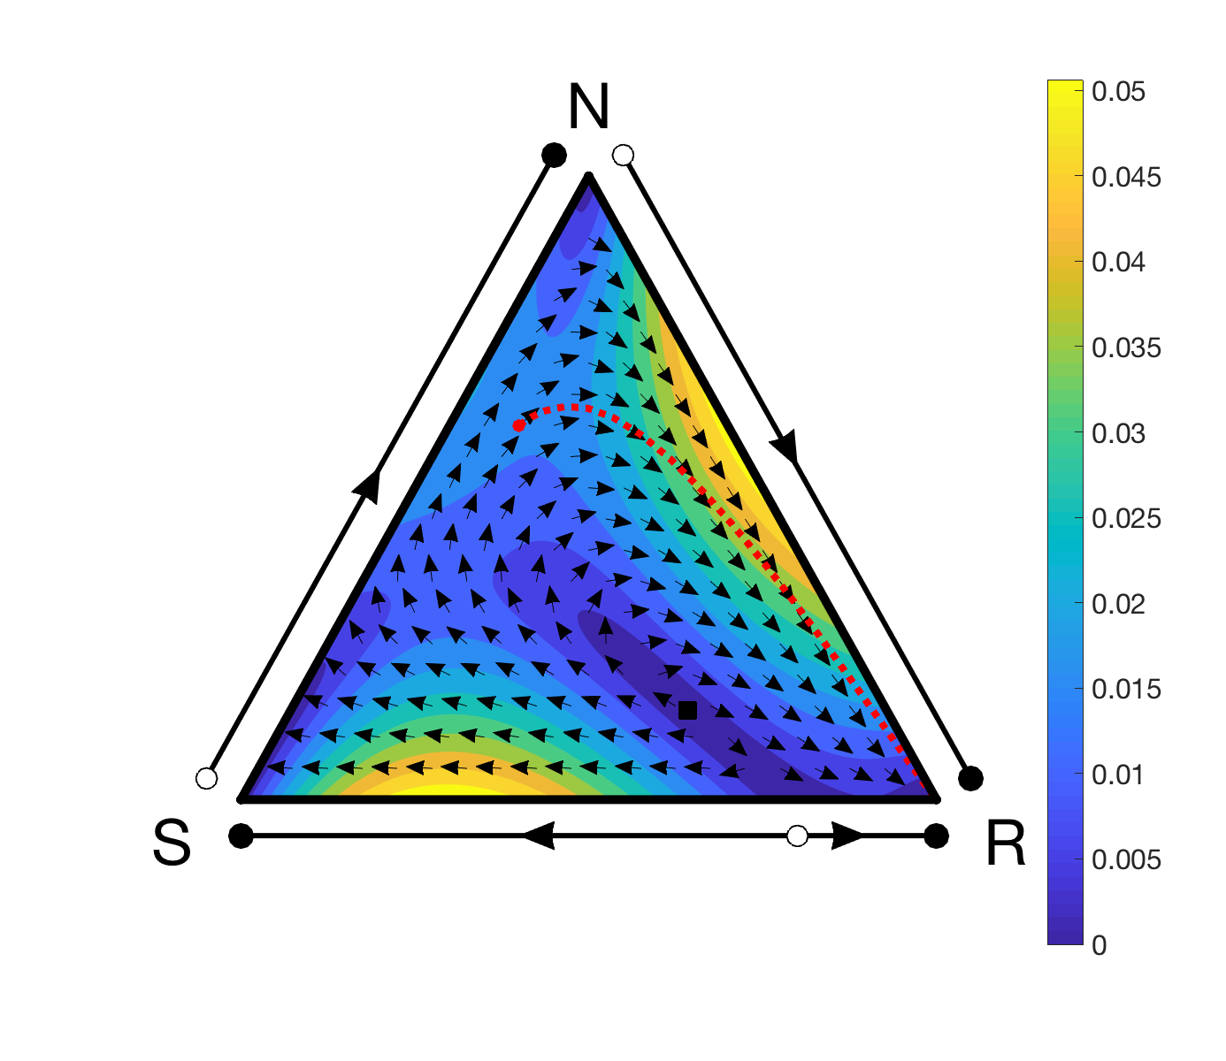
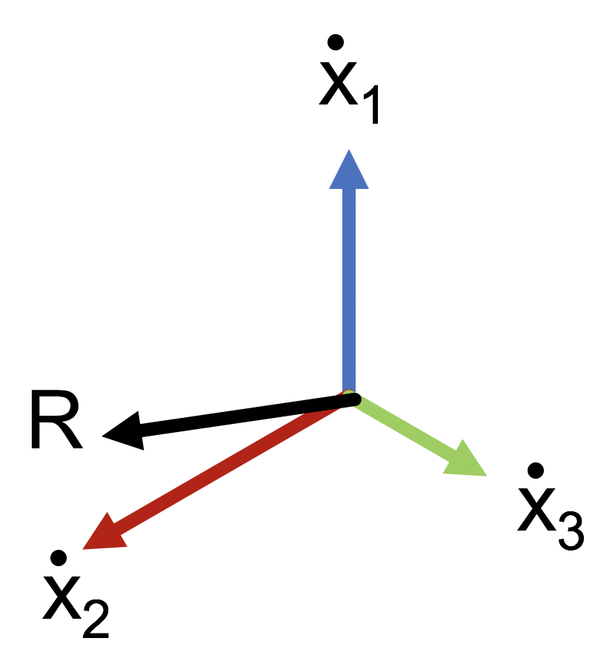
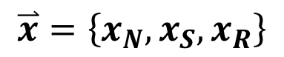
IsoMatrix: visualizing the isoclines of matrix games
Schematic
IsoMaTrix
N
$$\overset{⃑}{x}=\left\{x_{N},x_{S},x_{R}\right\}$$
x_{S}
x_{R}
x_{N}
S
R

Slide 41
IsoMatrix: visualizing the isoclines of matrix games
IsoMaTrix
isomatrix(A)
isomatrix_fixedpoint(A,index)
isomatrix_quiver(A)
isomatrix_isocline(A,id)
isomatrix_trajectory(A,x0,tF)
isomatrix_region(A)
isomatrix_velocity(A,id)
isomatrix_surface(A,id)
isomatrix_pairwise(A)

Slide 42
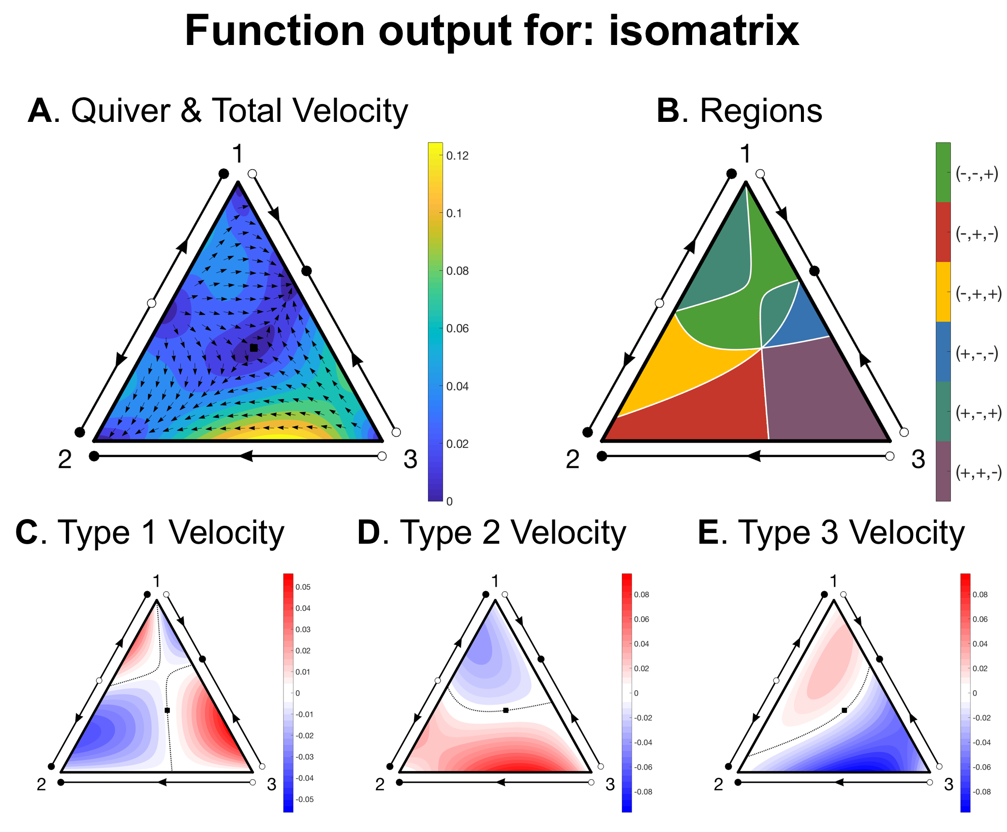
IsoMatrix: visualizing the isoclines of matrix games
MatLab Code:
A = rand(3, 3)
isomatrix(A)

Slide 43
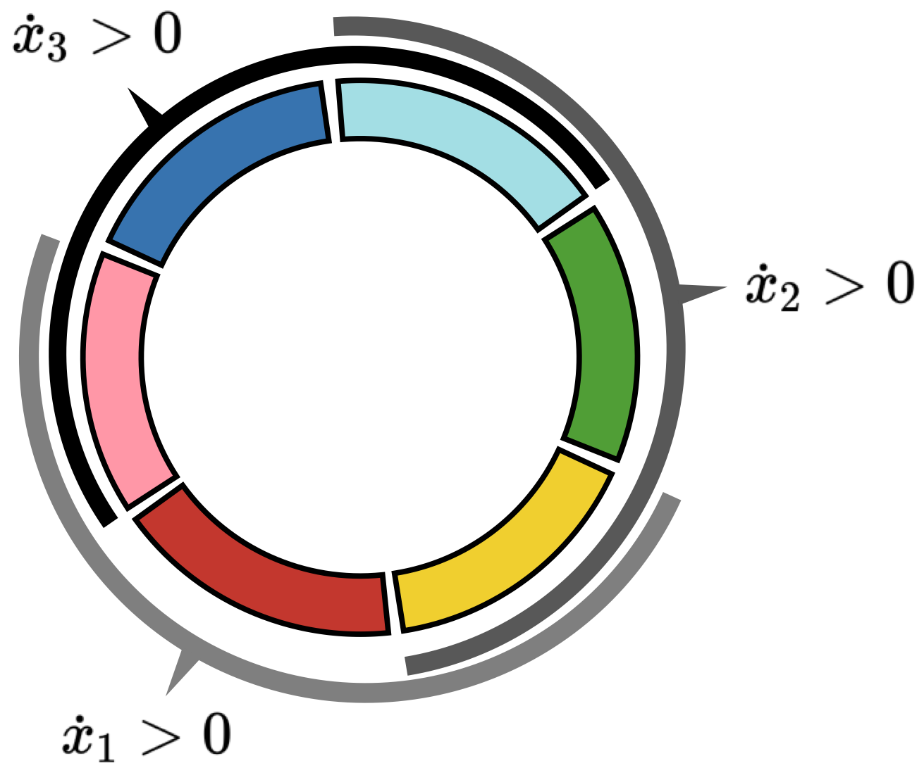
Isoclines delineate phase space into regions

Slide 44



Isomatrix used to visualize multiple games
D. Isoclines
Treatment dose
c = 0.00
c = 0.25
c = 0.50
c = 0.75
$${\dot{x}}_{R}>0$$
$${\dot{x}}_{R}<0$$

Slide 45






Isomatrix + HAL to quantify stochastic uncertainty
D. Isoclines
Spatial IsoMaTrix
Uncertainty
𝛳+σ
x_{F}
𝛳
x₀
𝛳-σ

Slide 46
3. The Prisoner’s Dilemma and Resistance
Competitive Release
“You can’t look at the competition and say you’re going to do it better. You have to look at the competition and say you’re going to do it differently.”
-Steve Jobs-

Slide 47
Resistance and the Prisoner’s Dilemma Cost of resistance
Fitness conferring Driver mutation
no therapy
Fitness cost
𝛾_{S} - 𝛾_{R}
Fitness
Low Fitness
Chemo
advantage
High Fitness
during therapy
Sensitive Cancer Cell
Resistant Cancer Cell
Chemo disadvantage
Healthy Cell
Notes:
0.3235 0.6018 0.0156 = g, d, f

Slide 48

Replicator equation dynamics Continuum limit of Moran dynamics
H
Replicator Equation
where:
length = 1
x_{R}
x_{S}
Unperturbed Tumor Growth (no therapy)
Treated Tumor Growth (drug therapy)
x_{H}
S
R
Notes:
c = [0.5, 0.6, 0.7]
p1 = 0.2
p2 = 0.18
p3 = 0.7
w = 0.1
scale = 25
f = 1e-3

Slide 49



Replicator equation dynamics Continuum limit of Moran dynamics
high
H
H
low
competitive release of
resistant population
good initial response
to chemotherapy
S
R
S
R
Unperturbed Tumor Growth
Continuous Therapy
Notes:
c = [0.5, 0.6, 0.7]
p1 = 0.2
p2 = 0.18
p3 = 0.7
w = 0.1
scale = 25
f = 1e-3

Slide 50
Dynamical phase portraits Using nullcline information for therapy control
high
Nullcline: line of zero growth ( )
low
region 3:
tumor is decreasing ( )
resistance is increasing ( )
Unperturbed Tumor Growth
Continuous Therapy
Notes:
c = [0.5, 0.6, 0.7]
p1 = 0.2
p2 = 0.18
p3 = 0.7
w = 0.1
scale = 25
f = 1e-3

Slide 51

Dynamical phase portraits Using nullcline information for therapy control
H
Proposed Adaptive Therapy Control Method:
Turn therapy “ON” until resistant nullcline is reached ( )
S
R
Notes:
c = [0.5, 0.6, 0.7]
p1 = 0.2
p2 = 0.18
p3 = 0.7
w = 0.1
scale = 25
f = 1e-3

Slide 52

Adaptive therapy Indirectly controlling the resistant population
figures from [West 2017]
Step 1
Fit data from metastatic castration-resistant prostate cancer patients
Step 2
Does a fitness cost to resistance emerge?
Step 3
Test adaptive therapy paradigm
Notes:
c = [0.5, 0.6, 0.7]
p1 = 0.2
p2 = 0.18
p3 = 0.7
w = 0.1
scale = 25
f = 1e-3

Slide 53
Publications
West, J., Z. Hasnain, J. Mason, P.K. Newton, “The prisoner's dilemma as a cancer model” Convergent Science Physical Oncology Vol. 3, Iss. 2, (2016)
West, J., Z. Hasnain, P. Macklin, P.K. Newton, “An evolutionary model of tumor cell kinetics and the emergence of molecular heterogeneity driving Gompertzian growth” SIAM Review, (2016)
West, J., P.K. Newton, “Chemotherapeutic dose scheduling based on tumor growth rates: the case for low dose metronomic high entropy therapies” submitted to Cancer Research (2017)
West, J., P.K. Newton, “Optimizing chemo-scheduling based on tumor growth rates” to appear in Mathematical Oncology Handbook (2017)
West, J., Y. Ma, P.K. Newton, “Harnessing the evolutionary cost of chemotherapeutic resistance by shaping the fitness landscape of a tumor” USC preprint (2017)
Thesis: “Computational Tumor Ecology: a model of tumor evolution, heterogeneity, and chemotherapeutic response”
Thank you
Collaborators
Sandy Anderson
Chandler Gatenbee
Joel Brown
David Basanta

